Slide 1
Particle detectors and experiments
Jeff Nelson

Slide 2
Outline
Particle physics overview
  Forces, particles
  Accelerators
  Particle detectors
Neutrino experiments
  Beams
  Detectors
  The next generation of experiments

Slide 3
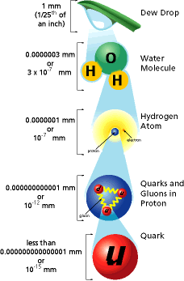
Sizes: Lets go smaller first

Slide 4
The 4 fundamental forces
Gravity
  It is the primary physics of objects in the Universe
  Is created by mass
  Always attractive
  The weakest force
Electromagnetic force
  Electricity and magnetism are part of the same force
  It is created by electric charge
  Can be attractive or repulsive (opposites attract !!!)
  Responsible for holding electrons to atoms, chemical bonds, and the sizes of objects
  The 2nd strongest force

Slide 5
The 4 fundamental forces
Strong nuclear force
  Binds the quarks into protons and neutrons
  Also for holding protons and neutrons into nuclei
    Must be a lot stronger than E&M since it easily overcomes the electric repulsion and binds more strongly
    Nuclei are much smaller than atoms
  Cancels out over distances larger than a proton or nucleus
  The strongest force
The weak force
  Only seen in some types radioactive decay, Solar fusion, and in the earliest times at the beginning of the Universe
  Only force that can change a particle’s type
    e.g. decay of a neutron to a proton
  2nd weakest force

Slide 6
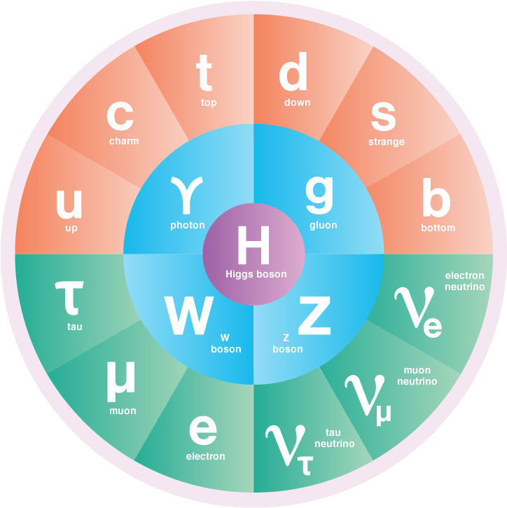
Elementary Particles
Force carriers in the middle

Slide 7
Elementary Particles
Strong
Force

Slide 8
Elementary Particles
Q = 2/3e
Q = -1/3e
Electromagnetic
Force
Q = -1e
Q = 0

Slide 9
Elementary Particles
Exchange
W or Z
(massive force
carriers
-> short range)
Weak
Force

Slide 10
Cute interactive version
www.symmetrymagazine.org/article/july-2015/standard-model

Slide 11
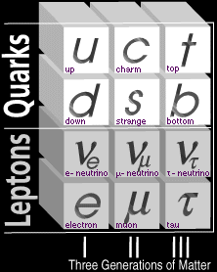
The Periodic Table of Elementary Particles
3 generations
Same physics
but more massive
in each generation
Higher generations
are unstable & decay
to lower generations

Slide 12
Making high energy beams of particle

Slide 13
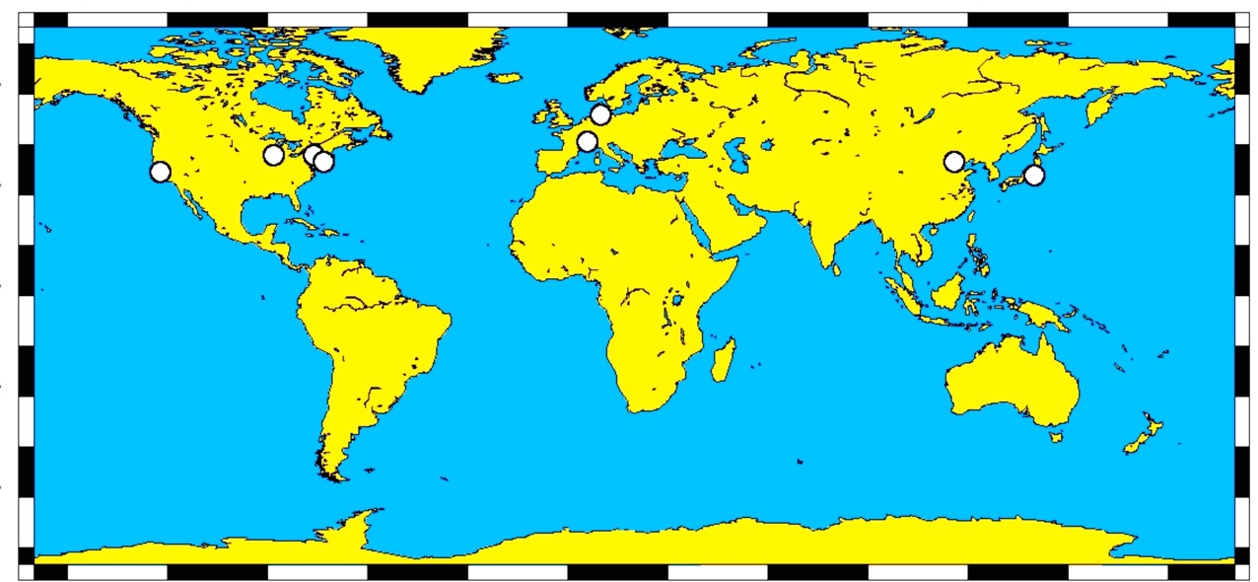
Some High-Energy
Accelerator Facilities
Fermilab
JPARC
Brookhaven
BES
CERN
KEK
Jlab

Slide 14
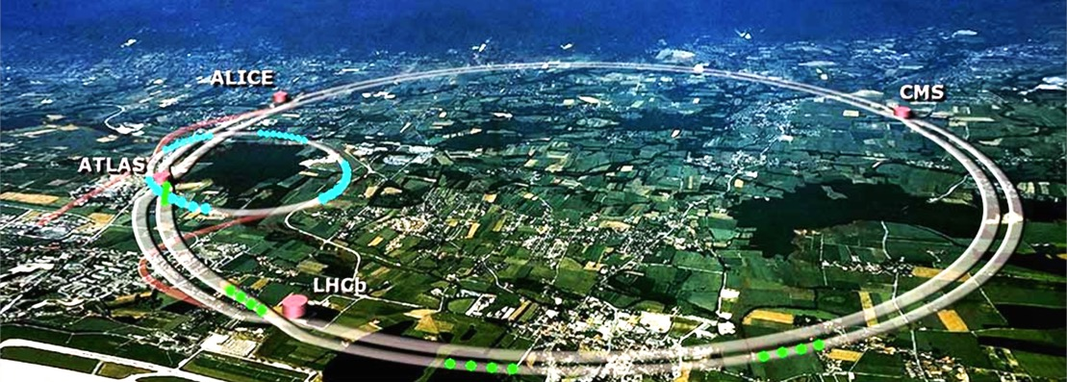
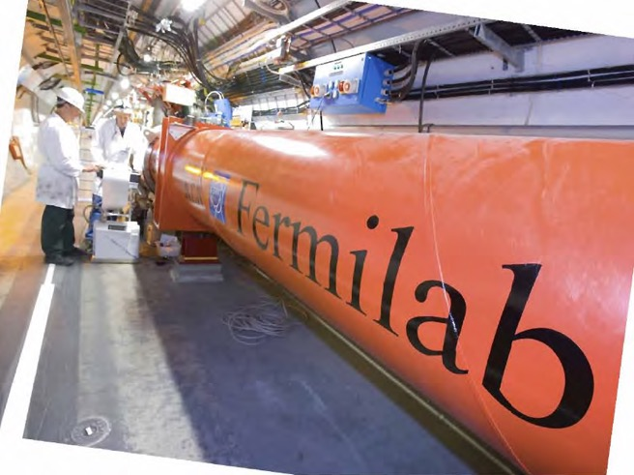
Particle Accelerators
CERN – Large Hadron Collider
13+13 TeV proton-proton accelerator

Slide 15
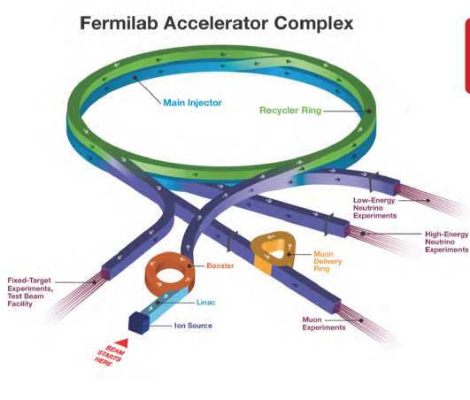
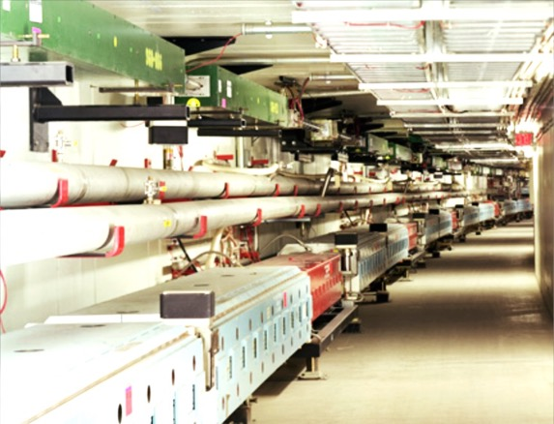
Fermilab

Slide 16
Detecting particles

Slide 17
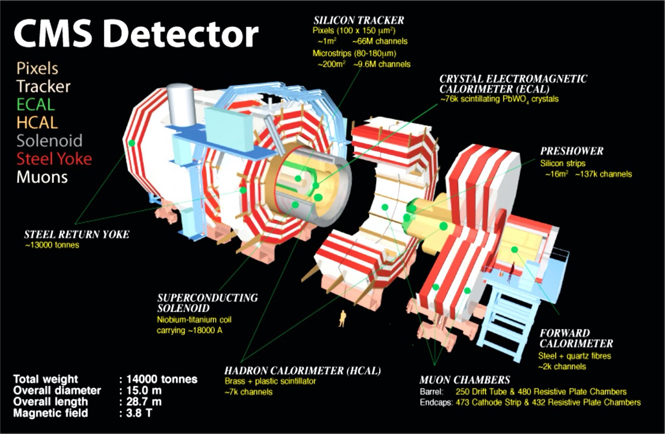
Detecting Collision Products

Slide 18
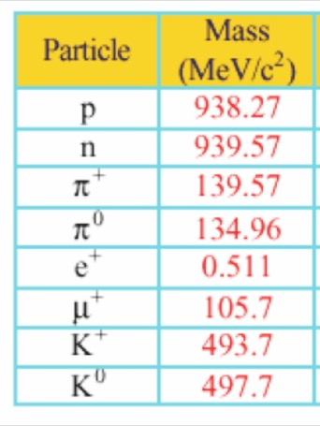
Experimental Goals
We’d like to get the four vectors for each of the particles in the final states of an interaction
  Mass & momentum
  Requires at least two measurements of the particle
  At least one needs to be “non-destructive”
Complications due to
  Most particles decay before they
  can be detected
    Most common things to try to detect ➔
  Background from other interactions
  Ambiguities
  Not all particles are created equal:
  some are harder to detect than others!

Slide 19
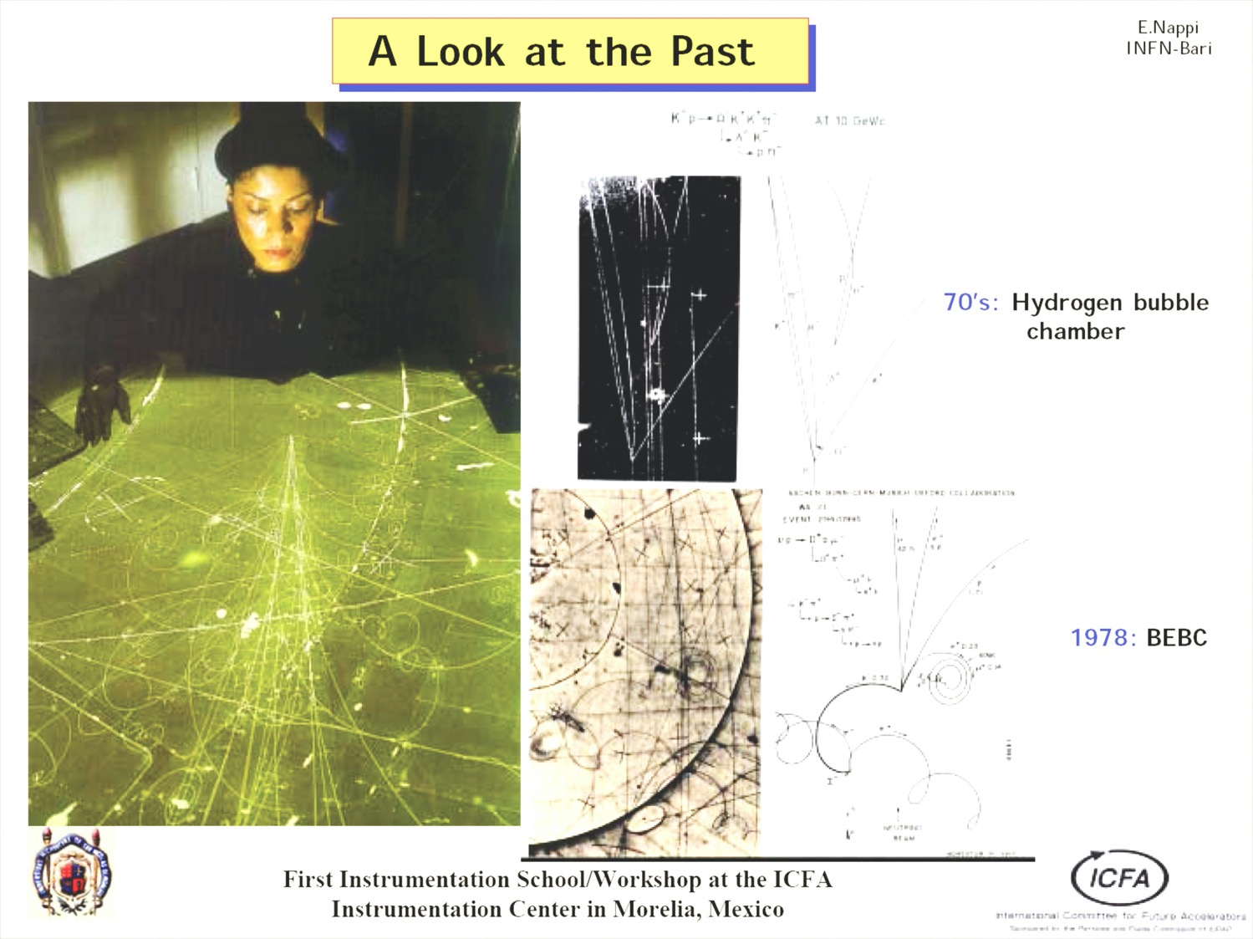

Slide 20
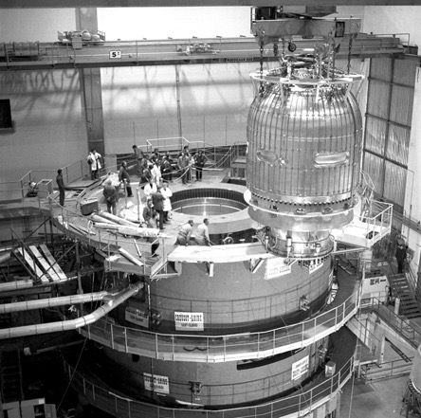
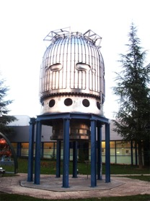
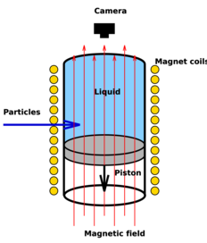
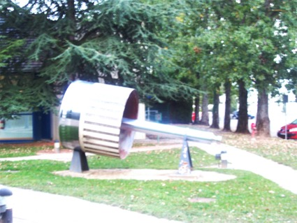
Bubble chambers
Make a superheated liquefied gas & put it in a magnetic field
  Near boiling point & a large piston to put it past
Particles would dump energy into the liquid and make bubbles
Literally take a picture
  Make measurements on the printed photos
  Very precise
  Very labor intensive – fleets of “scanners”
  (like prior page)
Particle identification possible
  Decay modes
  Lifetimes
  Some particle identification
    More on this later
BEBC
(CERN)

Slide 21
A track in a magnetic field gives us the momentum and the charge
e+
e-
r = 0.3Bp where r [m], B [T], p [GeV/c]

Slide 22
Modern world
Use a gas, liquid, or solid and look for electrons kicked out of the gas by charged particles
Electronic readout
  Much faster rates
  Automated analysis and reconstruction
  Mostly lower resolution

Slide 23
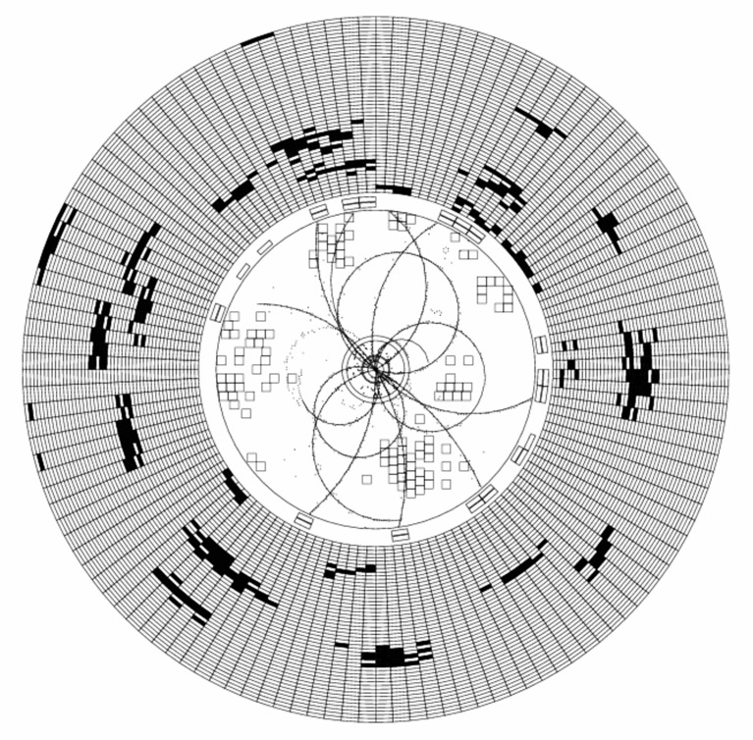
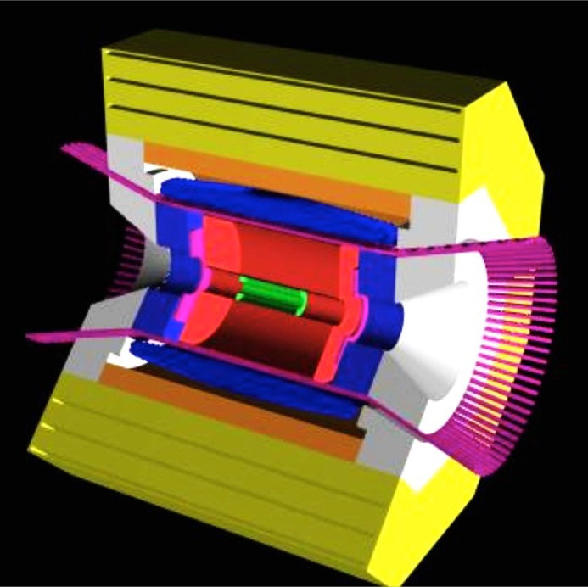
An event display from a detector (CLEO2, Ca. 1990) electron-positron collision (5+5 GeV)

Slide 24
Particle Identification
Need something in addition to momentum to get mass
  Time of flight
    Velocity vs momentum to get mass
  Electrons knocked off of atoms by high speed charged particle
    Rate of ionization (dE/dx) is a function of velocity
  Cherenkov radiation
    Threshold and ring size depend on velocity
  A few others:
    Radiation damage in a solid (volume damaged ~ dE/dx)
    Penetrating power (how far can penetrate)
    Transition radiation (electrons radiate strongly)
    Decay kinematics
    Distribution of deposited energy (electrons radiate strongly or short tracks)

Slide 25
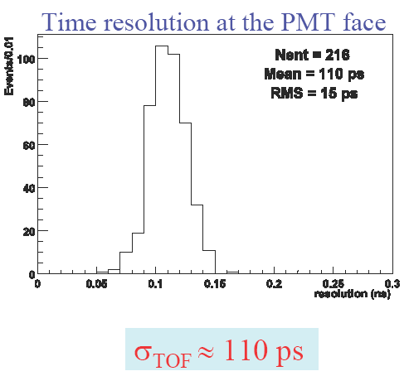
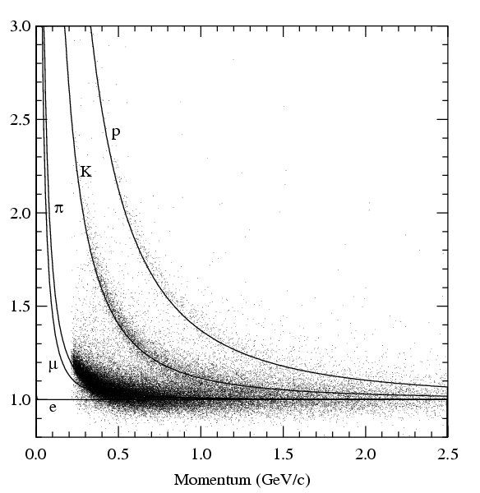
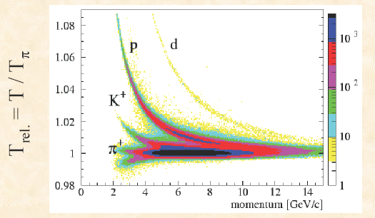
Examples
Time of flight
Ionization (dE/dx) in gas

Slide 26
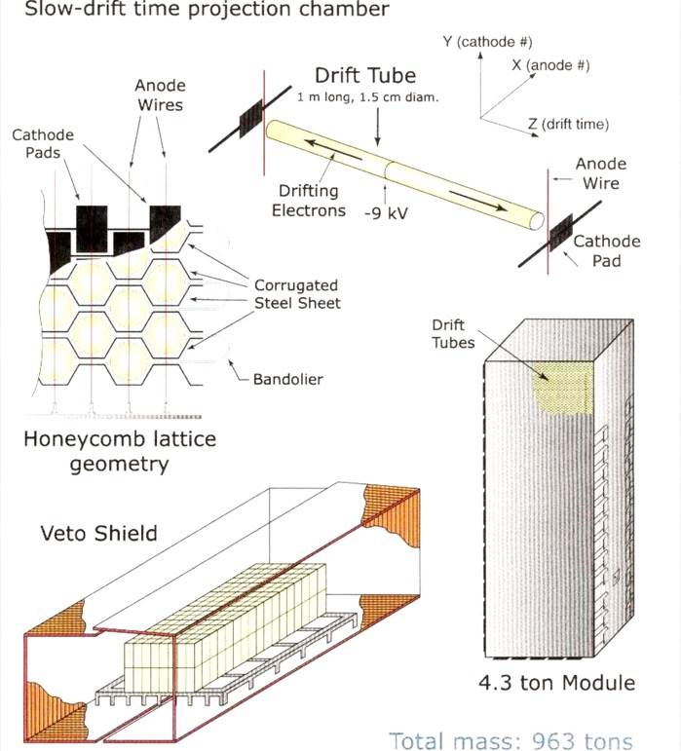
Other options for tracking
Time projection chamber
  Liquid or gas – shower to get gain
  Use long drifts to measure 3rd
  dimension with timing of electron drift
  Slower & less readout channels
Ionization in a solid
  Use silicon to do the same thing
  Can use typically 10 um wide strips
  or pixels
    Very low gain ~3000 electrons
    because we do not have the gas gain
  Many millions of pixels in typical
  modern detectors
Molecular damage
  Photographic plates

Slide 27
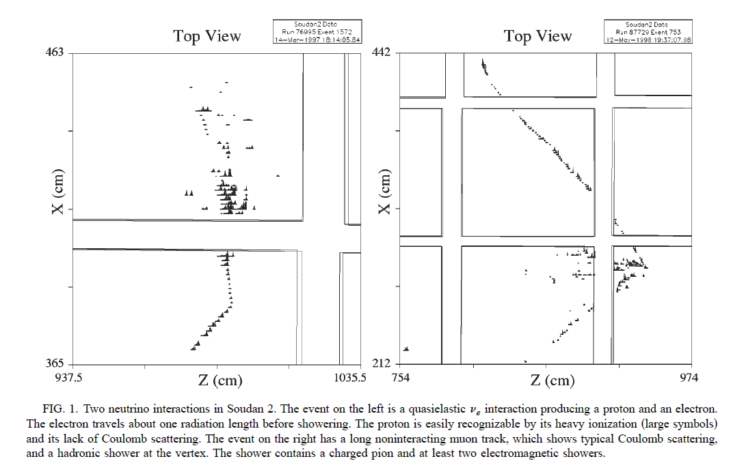
A gas-based drift chamber
(You have all seen liquid based from projects here)
muon
Electron shower
Hadronic shower

Slide 28
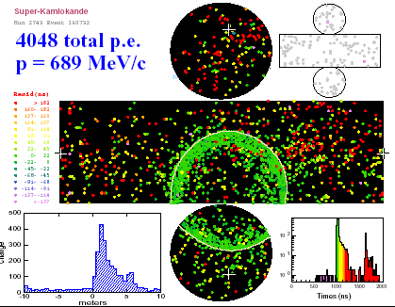
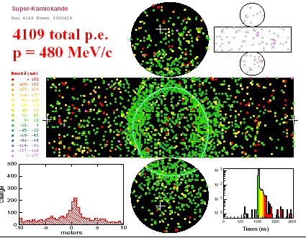
Cerenkov Rings in SuperK detector in Japan
Note fuzzy vs clear outer edge

Slide 29
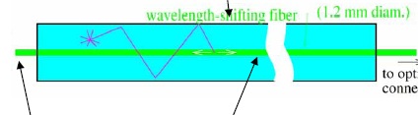
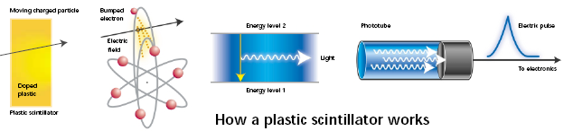
Scintillation
M-64 PMT
PMT Box
Clear fiber
Moving
charged particle
Bumped Electron
Energy level 2
Electric Pulse
Photomultiplier Tube
Light
Energy level 1
1 photon = 10⁶ e⁻
scintillator
Notes:
c/k

Slide 30
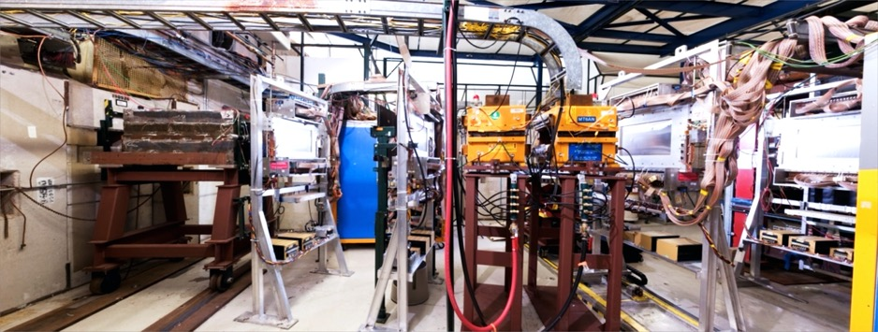
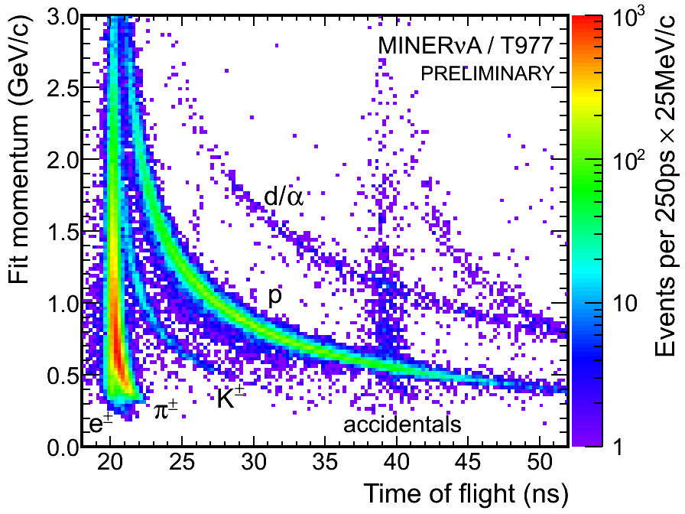
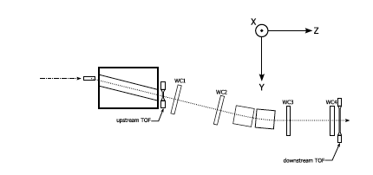
A small experiment:
MINERvA test beam experiment

Slide 31
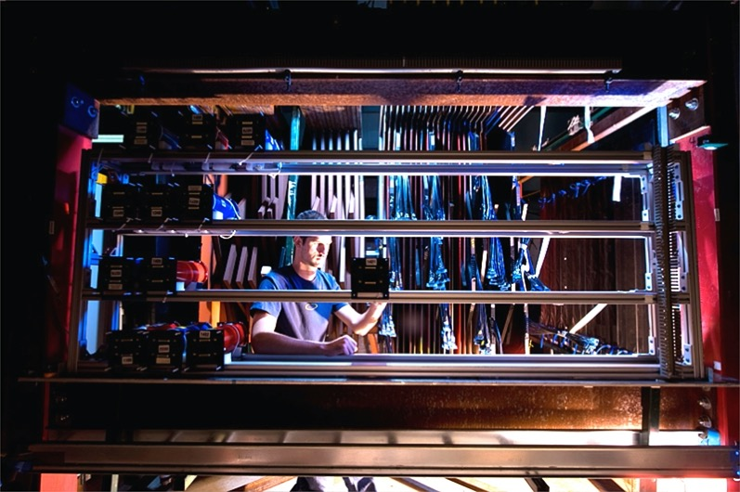
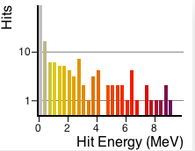
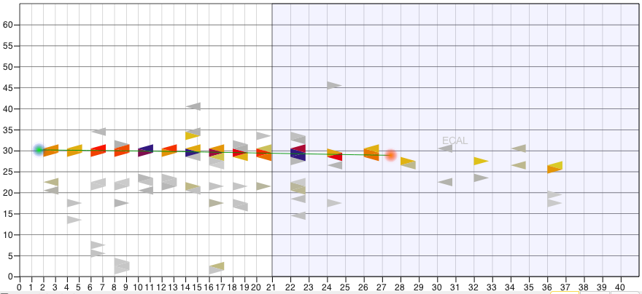
A small experiment: the MINERvA test beam experiment
640 MeV electron

Slide 32
A neutrino story

Slide 33
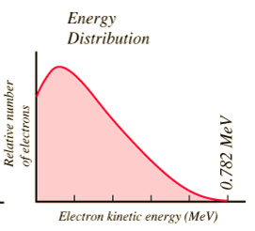
The Missing Energy Problem
Isolated neutrons have a 13min half life
  They were observed to decay to a proton and an electron
The problem
  They should have been back
  to back and mono-energetic if
  it was a two-body decay
  A continuous spectrum was
  observed
  When adding up the momenta
  of the observed decay
  products, energy was missing
Missing Energy

Slide 34
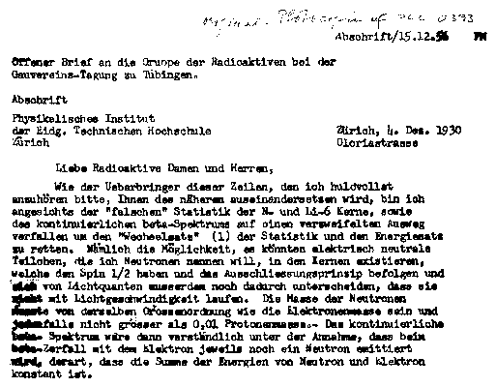
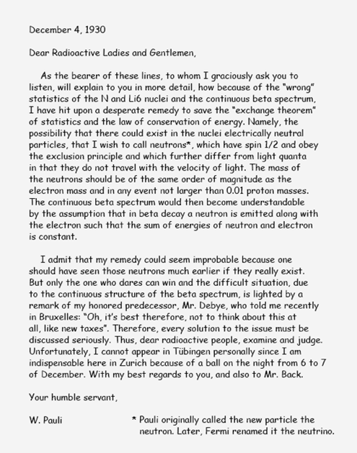
“I have hit upon a desperate remedy…”
Pauli proposes that a
  New
  Chargeless,
  Massless,
  Weakly interacting
particle is also being produced
Missing Energy

Slide 35
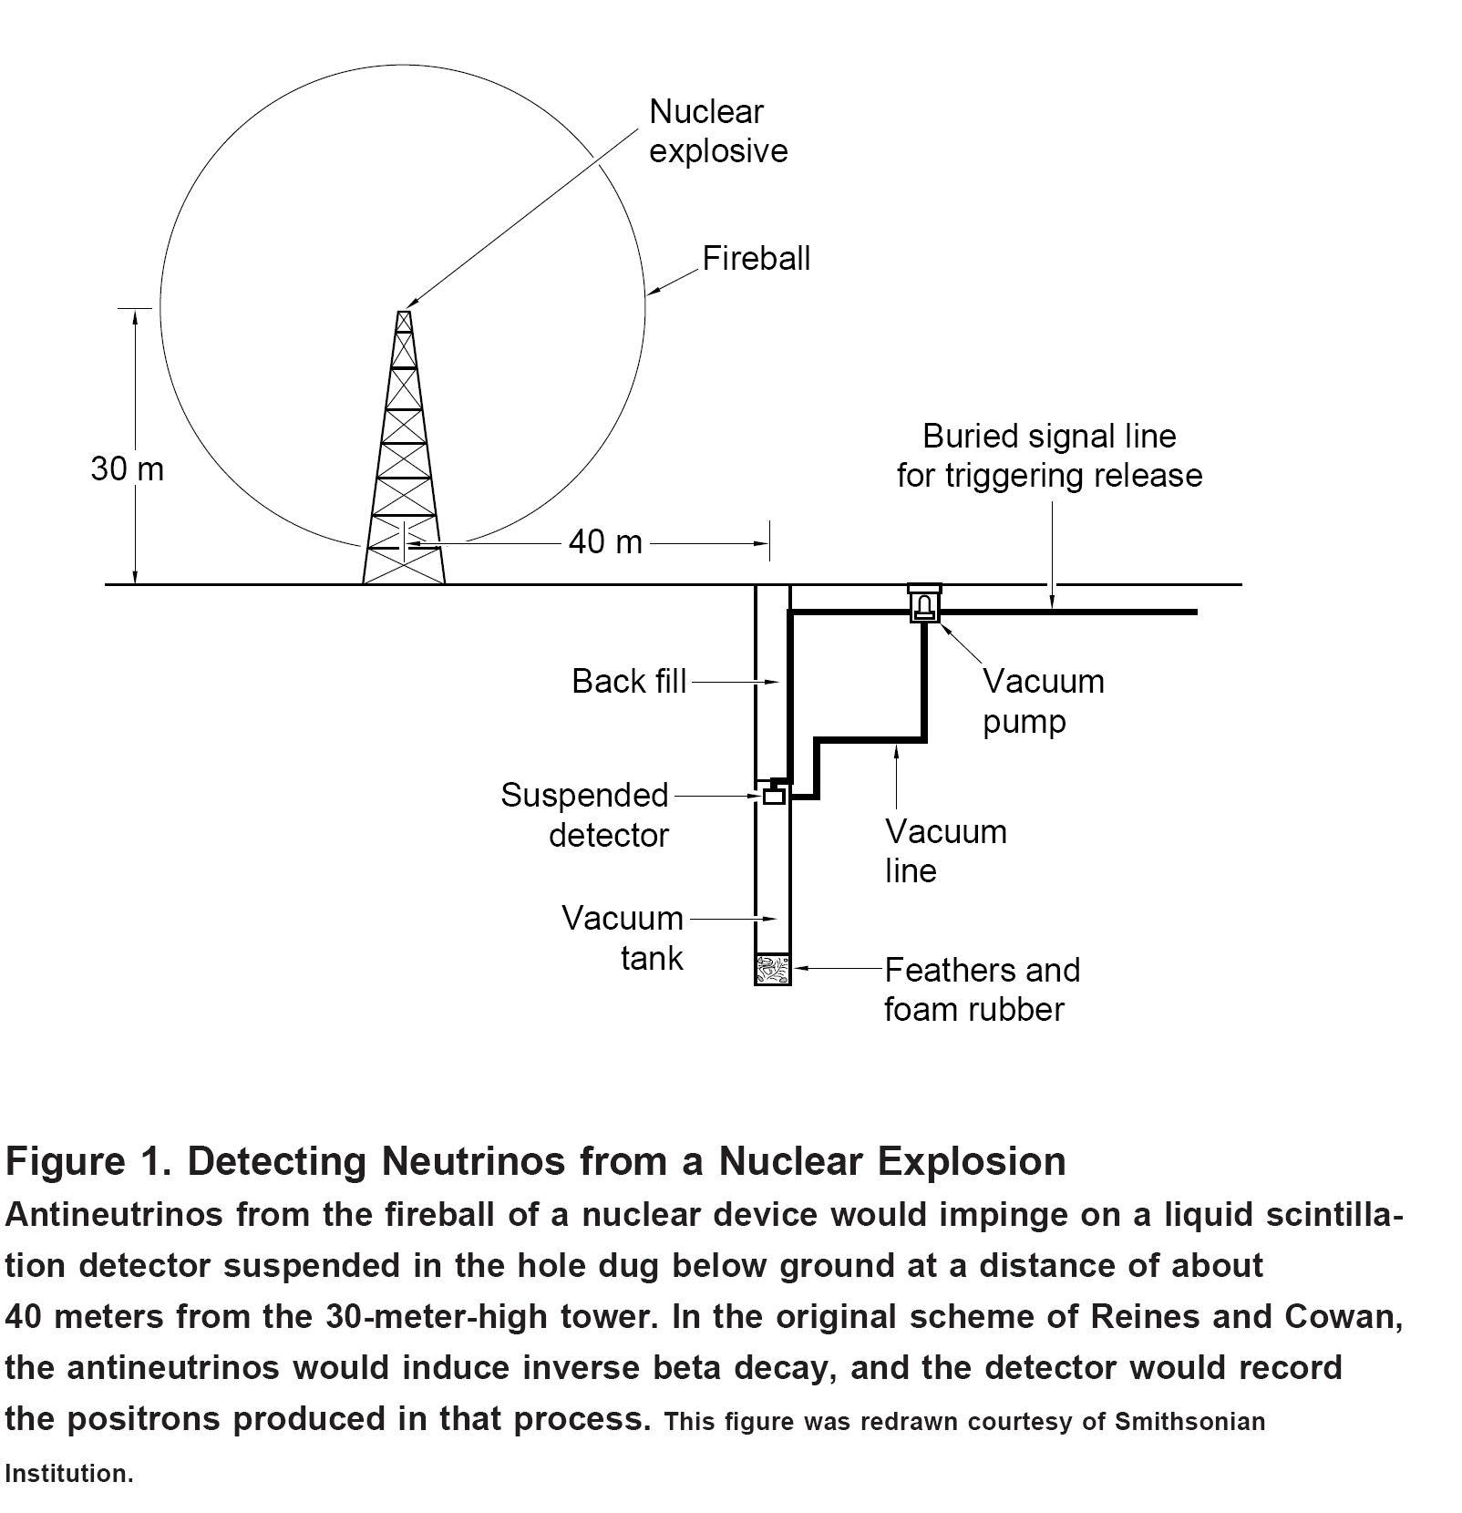
Their original experimental concept

Slide 36
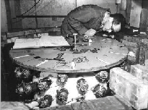
Later they were seen
In the 1930 nuclear reactors were not in the forefront of people minds
As they came to being,
people tried to see the
reactor’s neutrinos in
scintillator counters
In 1956, Frederick
Reines and Clyde Cowan,
report the first evidence
for neutrinos

Slide 37
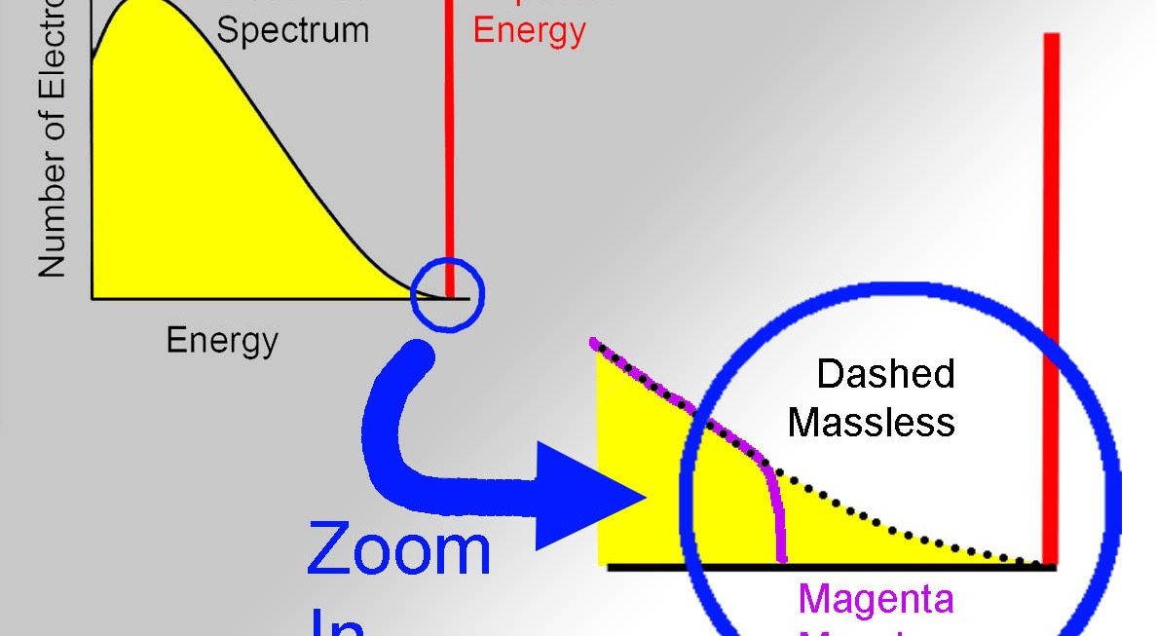
Neutrino mass from the end-point method

Slide 38
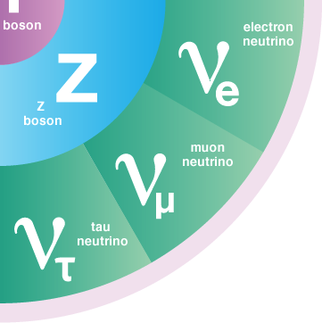
Takeaways
Understanding there were
more than 1 type = Nobel
Only the weak force for work with …
  Most particle detection methods rely on particles being charged or looking for decays
Neither work for neutrinos
  This means we need to work indirectly

Slide 39
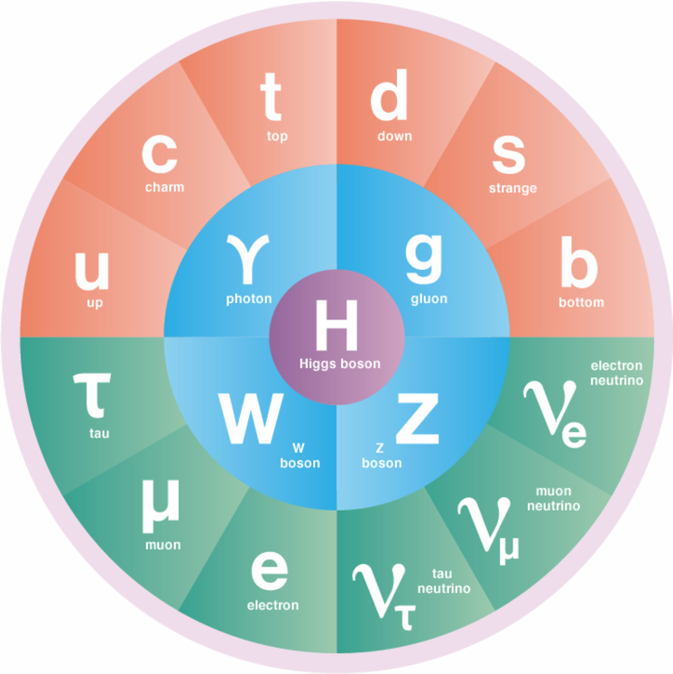
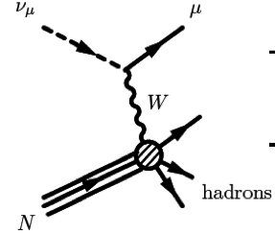
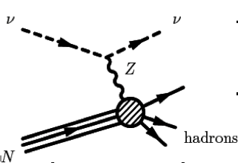
Neutrino interactions
Charged current (CC, W exchange)
  Lepton tags neutrino, all energy
  seen, threshold due to lepton mass
Neutral current (NC, Z exchange)
  Outgoing neutrino – no energy threshold
  Missing energy & no flavor information

Slide 40
Neutrino experiments: exercises in forensics
We cannot see the neutrino
We only know they are there by looking for the results of their interactions
We take the final state particles and infer the energy and type of the incoming neutrino
  Forensics
Can also the “missing energy” technique to infer a neutrino was produced

Slide 41
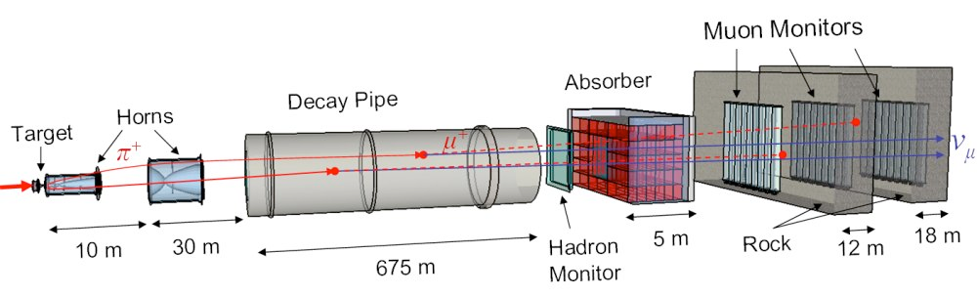
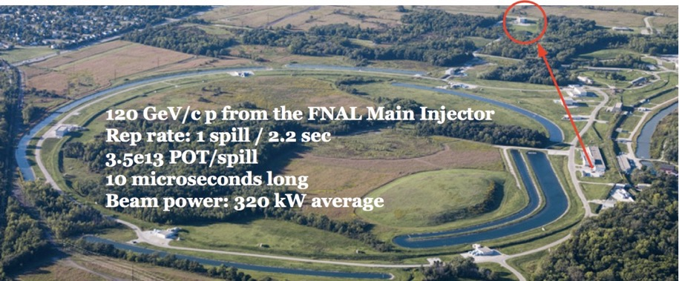
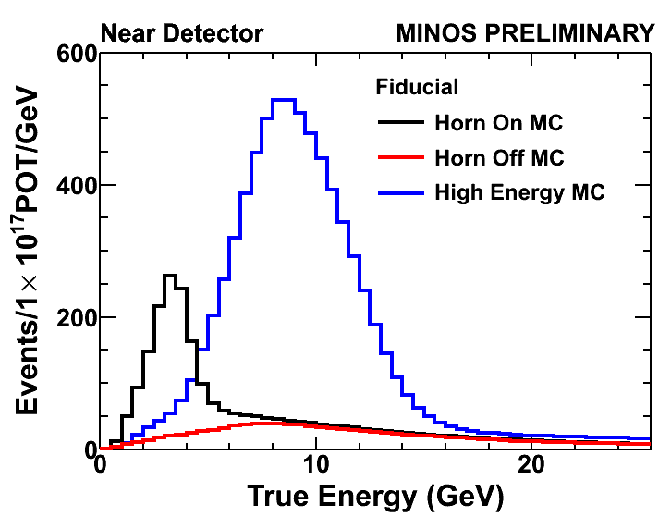
NuMI Neutrino Beam at Fermilab
MINOS ND
Target
Hall

Slide 42
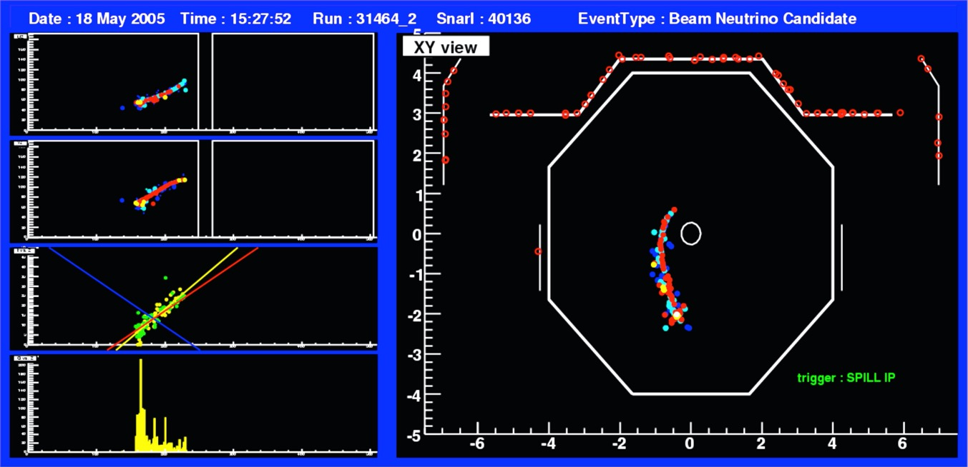
A Neutrino Interaction
(“An Event”)
Resulting muon bending in the magnetic field
Debris from struck nucleus

Slide 43
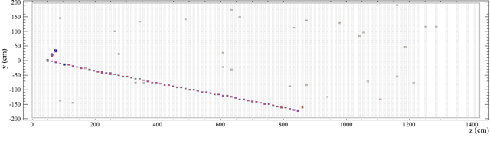
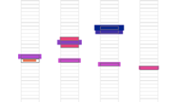
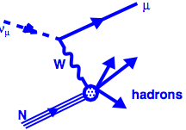
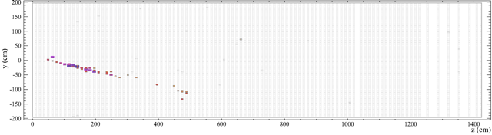



Simulated events in NOvA
(1st results this summer… but that’s another seminar)
p⁺
μ
ν
e
Small shower from 2nd γ

Slide 44

Neutrino interactions
We need to estimate the energy
of the incoming neutrino
  Different from the “visible”
  energy seen in the detector
Neutrino oscillation experiments
use high Z nuclei as targets (e.g. Fe)
  This affects the visible energy …
  Number of final state particles
    We are not sensitive to their rest masses
  Intra-nuclear absorption and scattering
  Motion of struck nucleon within nucleus

Slide 45



MINERvA
Finely segmented solid scintillator (CH) detector on axis in NuMI
  Active tracker is all scintillator
  Calorimeters are scintillator w/ Fe or Pb
Targets of Iron, Pb, C, Fe, H₂O & He
MINOS detector for muon spectrometer
Test beam program for energy scale/detector model
NIM A743 (2014) 130
NIM A789 (2015) 28

Slide 46


The MINERvA Collaboration
Notes:
9 countries

Slide 47

MINERvA detector
A fine-grained scintillator
Detector with many different
Nuclei for targets

Slide 48


A neutrino interaction in MINERvA
MINERνA Data
neutrino beam
Muon
Strip Number
Proton
Pion
Module Number

Slide 49


Quasi-elastic scattering
MINERνA Data
Neutrino Quasi-Elastic Candidate
Strip Number
neutrino beam
Muon
νμ
μ⁻
n
Proton
p
Module Number

Slide 50


Electron neutrino CC QE:
Large signal for electron appearance

Slide 51

Results: pion production
MINERνA Data
Neutrino resonant charged pion production candidate
neutrino beam
Muon
Strip Number
Proton
Pion
Module Number

Slide 52

Results: pion production
MINERνA Data
Antineutrino resonant neutral pion production candidate
Strip Number
Module Number

Slide 53

Pizero mass peak after sideband fits

Slide 54


Coherent charged pion production
MINERνA Data
neutrino beam
Muon
Pion
Neutrino Coherent Pion Production Candidate
Strip Number
Module Number
Neutral pion NC analog is a background to
electron neutrino appearance measurements

Slide 55

Hyper-Kamiokande (T2HK)
560 kT fiducial water Cherenkov detector
  25x Super-K
Upgraded beam
  295 km, off-axis
In Japanese funding discussion

Slide 56

1200 collaborators from around the world…

Slide 57


MINOS and NOvA Detectors
DUNE
Detector
New beam line with higher power at a longer baseline (LBNF)
Should start collecting data sometime in middle of next decade

Slide 58


Slide 59

40 kT liquid argon Time Projection Chamber (TPC)
  Roughly the size of Super-K
Located in the Homestake mine in South Dakota with
a beam at Fermilab
  1300 km baseline, on-axis

Slide 60


DUNE R&D at W&M
We are in the process of upgrading a (6m)³ prototype detector called ProtoDUNE which will be tested in a particle beam at CERN
Prior to that we built a prototype of a prototype (1.5m)³
Ramped it up to voltage (185kV) and see if it hold charge
  Not quite!

Slide 61

ProtoDUNE at CERN

Slide 62




Slide 63



Slide 64


Slide 65


Slide 66

A particle beam test of detecting ionization, compared to simulations

Slide 67


Slide 68


