Slide 1
Biomedical Imaging and Optical Tweezers
February 22, 2024
Undergraduate Seminar
Bjorg Larson
Physics Department
Notes:
Assistant professor in Physics Dept
Previously at Memorial Sloan-Kettering Cancer Center
Currently building a lab with two students here at Drew!

Slide 2
A little bit about me…
Undergraduate projects:
Simulating hot star winds
  Learned Fortran and C++
Wound extruded aluminum into coils for a plasma experiment
  Learned experiment troubleshooting
String theory
  Used a lot of my math and group theory
Graduate school:
Short project on high energy experiment
X-ray microscopy and spectroscopy
  Synchrotron! Vacuum chambers! And teeny tiny samples.

Slide 3
Postdoc
Sloan-Kettering Cancer Center
In the dermatology department, there was an imaging group

Slide 4
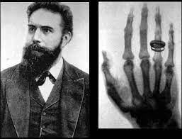
A short history of medical imaging
Roentgen’s first human x-ray image in 1895 was revolutionary to the practice of medicine.
100 years later: conventional tomography, computed tomography
Continuous push toward higher resolution, faster times, larger scan areas and lower dose.
Image contrast is from density differences

Slide 5
MRI (NMR)
Magnetic Resonance Imaging (Nuclear Magnetic Resonance)
Strong magnetic field around patient, then radiofrequency pulses to excite protons. The relaxation of protons produces a signal
MRI can be combined with other techniques
Soft tissue imaging

Slide 6
Ultrasound
High-frequency sound waves: we’re imaging the echo!
No ionizing radiation
Nuclear Imaging
Radioactive tracers

Slide 7
Interventional Imaging
Optical imaging (visible light)
Send a camera inside the body!

Slide 8
Confocal microscopy for cancer

Slide 9
Skin cancers – per year, in the USA alone
1.2 million new cases
5.5 million biopsies
80% ~ 4.3 million biopsies are normal or benign
cost ~ $2.2 billion/year, to detect “normal”
Can we detect cancer without a biopsy?
National Cancer Inst., American Cancer Society, 2008 statistics
www.cancer.gov/statistics; http://seer.cancer.gov/statfacts; www.cancer.org
800,000 basal cell carcinomas (BCCs)
300,000 squamous cell carcinomas (SCCs)
100,000 melanomas
BCCs: 2 million biopsies, 40% positive
SCCs: 2 million biopsies, 15% positive
Melanomas:1.5 million biopsies, 7% positive

Slide 10
Motivation:
Traditional diagnosis technique:
  Biopsy
  Fixation of tissue
  Slicing of tissue
  Staining of tissue
  View with 2x-40x magnification optical microscope

Slide 11
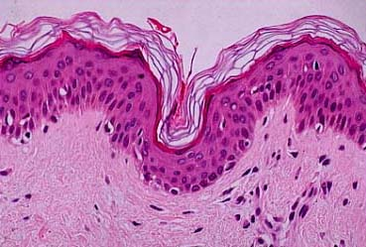
Motivation:
Traditional diagnosis technique:
  Biopsy 🡪 Painful!
  Fixation of tissue 🡪 Hours to Days
  Slicing of tissue 🡪 15 – 20 um
  Staining of tissue 🡪 H&E (hemotoxylin & eosin)
  View with 2x-40x magnification optical microscope:

Slide 12
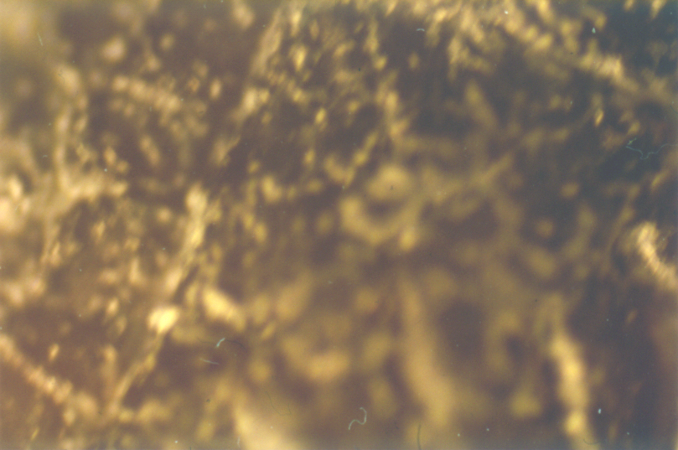
Conventional microscope
image of human skin in vivo
Pathology
No optical sectioning 🡪 Biopsy, physical sectioning
No rejection of out-of-focus light

Slide 13
Proposed improvement to existing standard:
Optical microscopy on unprocessed tissue
  In vivo
    Image directly on the patient
      In the clinic -or- in the operating room
  Ex vivo
    Image directly on freshly excised tissue
      On biopsies -or- at the bedside

Slide 14

“POINT” SOURCE
OF LIGHT
Confocal microscope
“POINT” DETECTION
APERTURE (PINHOLE)
DETECTOR
PIXEL on detector
OBJECTIVE LENS
Out-of-focus light is rejected
illuminated VOXEL in tissue
TISSUE

Slide 15
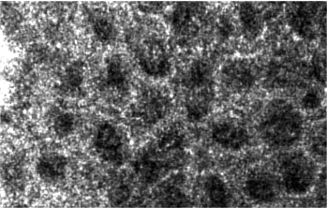
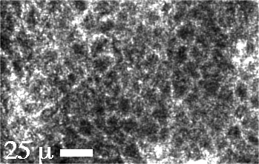
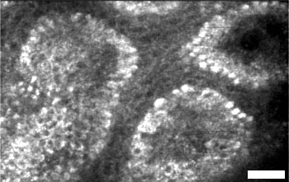
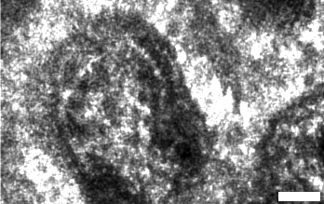
Confocal imaging in skin
SCANNER
En face
confocal images
En face optical section
SKIN
Notes:
‹#›

Slide 16
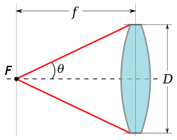
Resolution
And
Optical Sectioning
Depend on wavelength or COLOR of the light used
Depend on how sharply the objective lens focuses.
Other considerations:
-Long wavelengths scatter less in tissue, therefore allow deeper imaging
-Small pinhole leads to speckle noise, but larger pinhole reduces both lateral resolution and axial sectioning
NA = nsinθ

Slide 17
Resolution: diffraction-limited
Basics of resolution
Relation between NA and resolution
Depth of focus/Depth of field

Slide 18
Light back-scattering produces
endogenous reflectance contrast
Nuclei appear dark
weak backscatter from chromatin
Cellular cytoplasm
appears bright
strong backscatter from organelles
Rajadhyaksha et al., J. Invest Dermatol, 1995
Rajadhyaksha et al., J. Invest Dermatol, 1999
Rajadhyaksha et al., J. Biomed Optics, 2004

Slide 19
This is great for skin…
But confocal microscopy only images 200 microns deep!
What about other cancers?
What if we could quickly image freshly excised tissues?
  Guide surgery: margin detection at the bedside!
  We can use dyes: better imaging contrast!

Slide 20
Imaging of Excised Tissue
Breast lumpectomy surgery
  Tumor is removed based on radiology and visual inspection
  Patient is sent home
    Frozen pathology not routinely performed due to fattiness of breast tissue
  Positive margins on excised tissue results in second surgery (re-excision rates can be as high as 60% at some institutions)

Slide 21
Imaging of Excised Tissue
Confocal microscopy has a small field of view (0.5 mm x 0.5 mm)
How can we image large pieces of tissue with high resolution?
🡪 Mosaicking (tiling of images)

Slide 22
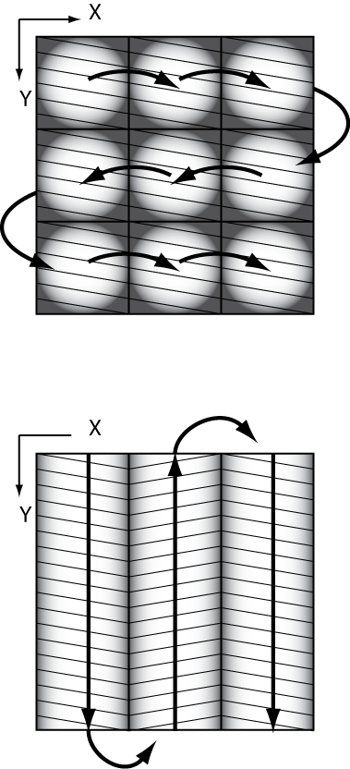
MOSAICKING STRATEGIES
Traditional mosaicking method :
Two Dimensional Mosaicking - individual square images merged
(Gareau D et.al, J. Microscopy 233: 149-159, 2009)
10 minutes to scan 10 x 10 mm²
New mosaicking method:
New Strip Mosaicking – image strips are merged in one dimension
- reduced acquisition time
- 50% reduction in merging time
- 50% of illumination artifacts due to falloff
Proof of Principle:
Abeytunge et.al, JBO Letters, 050504,
May 2011, Vol 16(5)

Slide 23
Synchronization
optical Scan
HSYNC
image strip
Velocity mm/sec
common constant velocity
start acquisition
image strip
Mechanical Scan
stop acquisition
stop acquisition
start acquisition
10 mm specimen
10,000 lines
0
2
12
14
stage position
mm

Slide 24
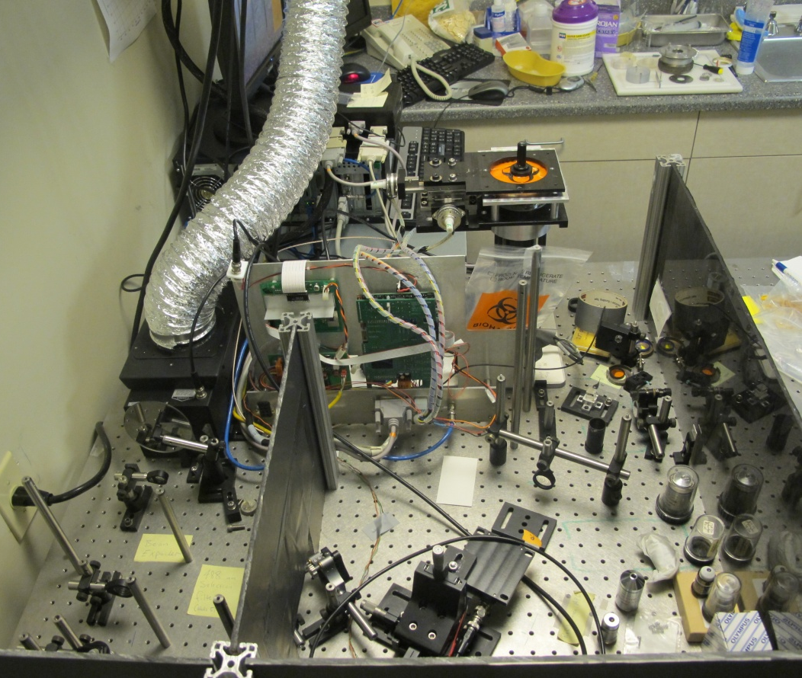
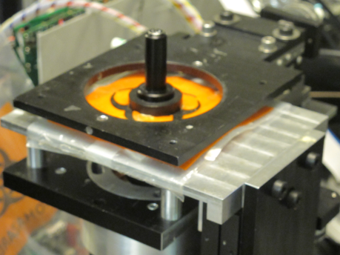
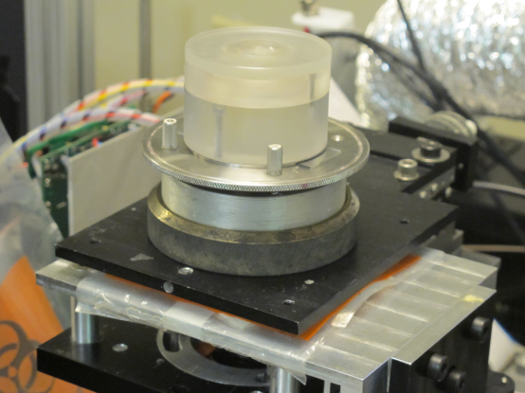
Previously: Bench-top development of Large Area Confocal Scanner
Patel et al., J. Biomed Optics 2007
Gareau et al., J. Biomed Optics 2008, 2009; J. Microsc 2009
Abeytunge et.al, JBO Letters, 050504, May 2011, Vol 16(5)
Objective
Lens
Tissue
Fixturing &
Mounting
PREVIOUSLY: Grant R01EB002715 from
NIBIB’s Image Guided Interventions Program

Slide 25
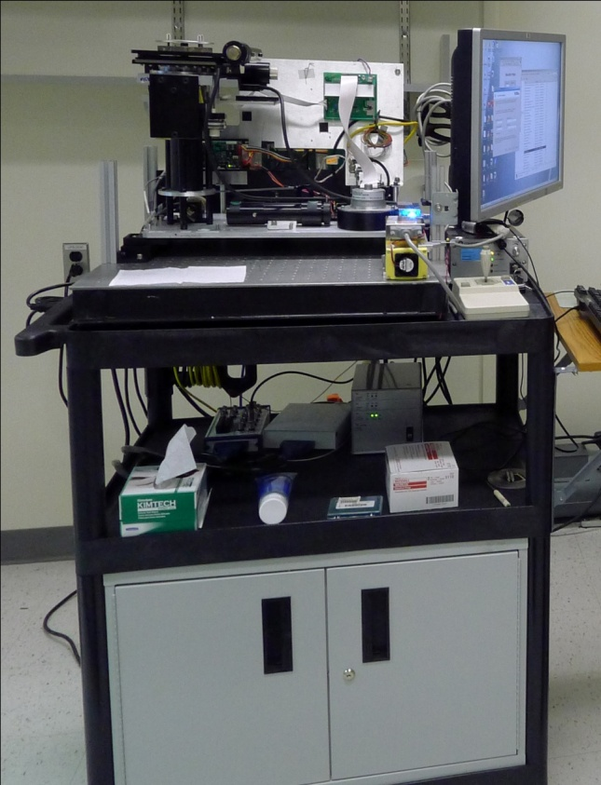
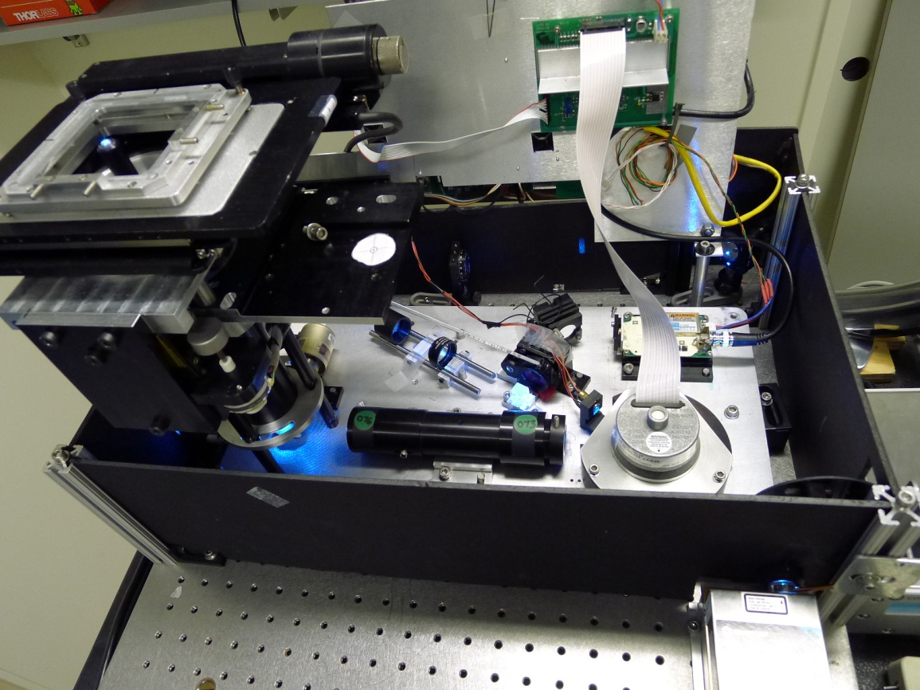
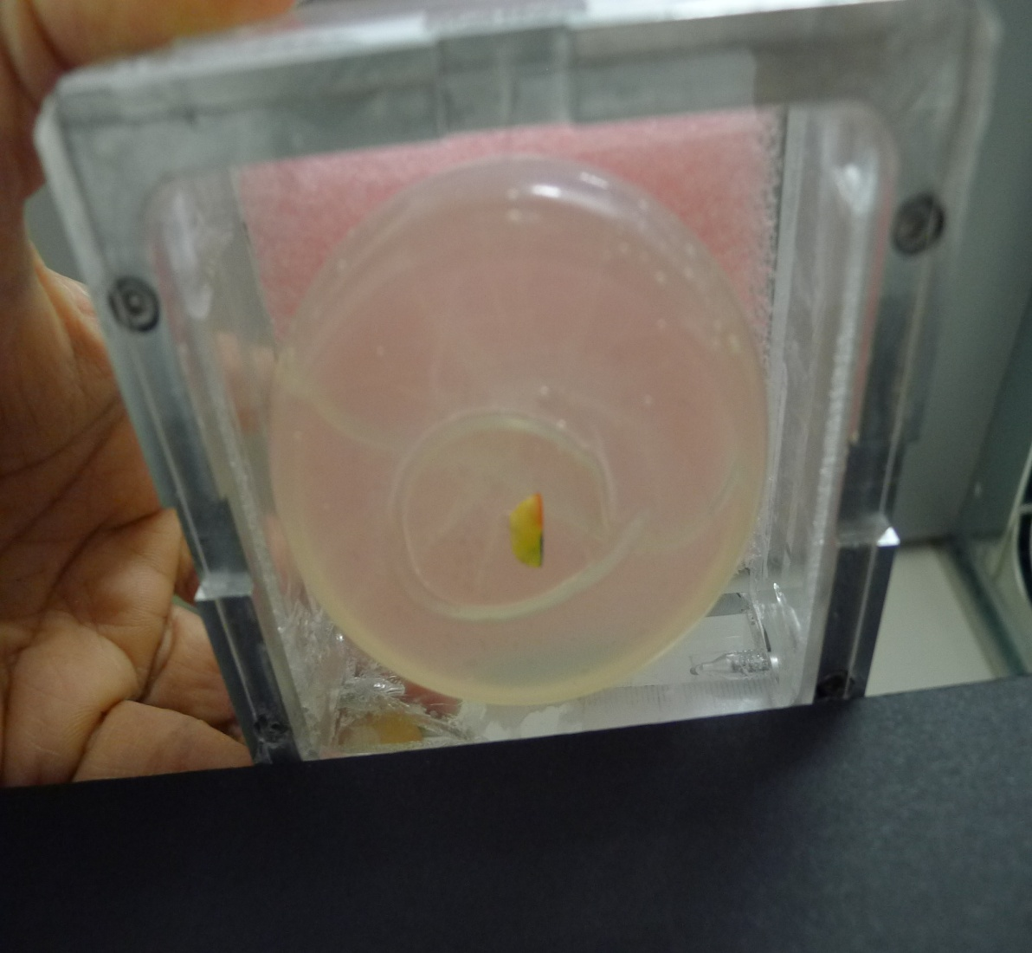
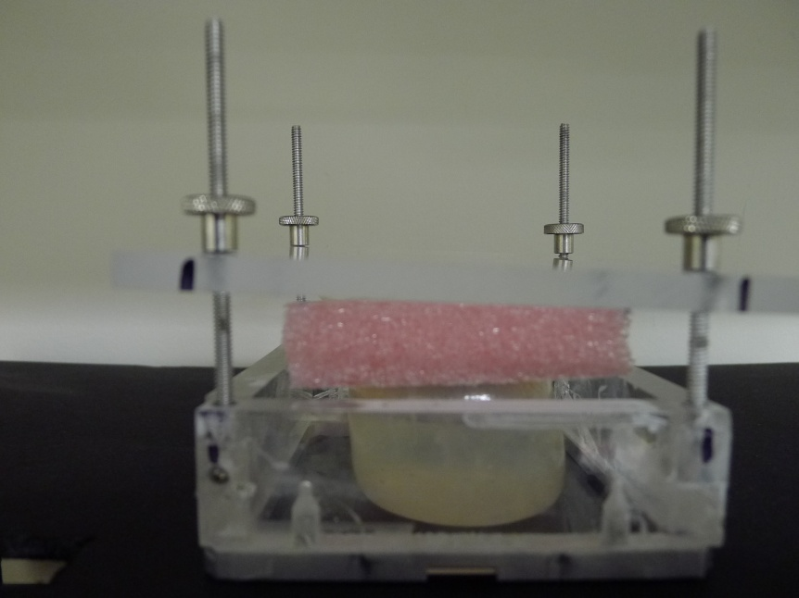
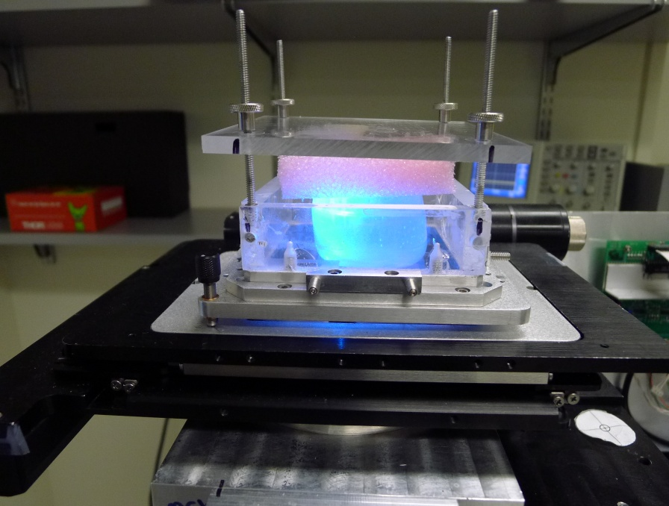
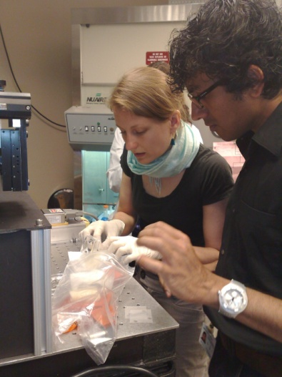
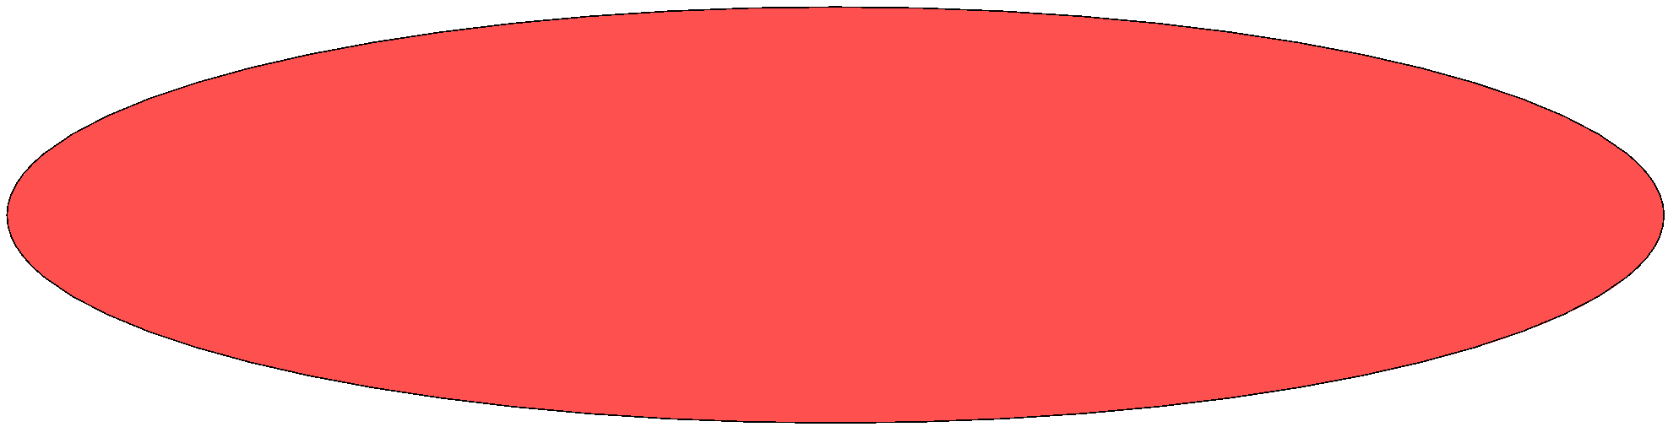

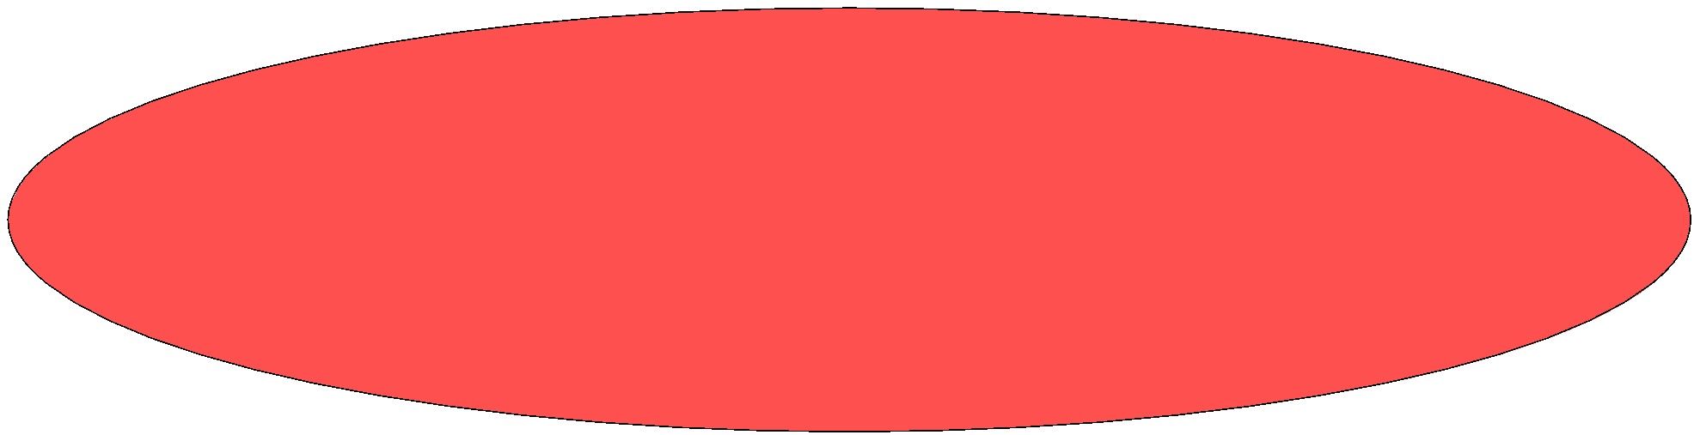
motor driven stage -mechanical scan
glass window
water bladder
Tissue Fixture
placement
water bladder
water bladder
polygon – optical scan
Mobile Large Area Confocal Scanner
water bladder
water bladder
excised tissue
In pathology
excised tissue
pressed tissue
excised tissue
excised tissue
Tissue Fixture on the stage
cover
water bladder
View from the bottom of the Tissue Fixture
confocal microscope
confocal microscope
water bladder
Tissue Fixture on the stage

Slide 26
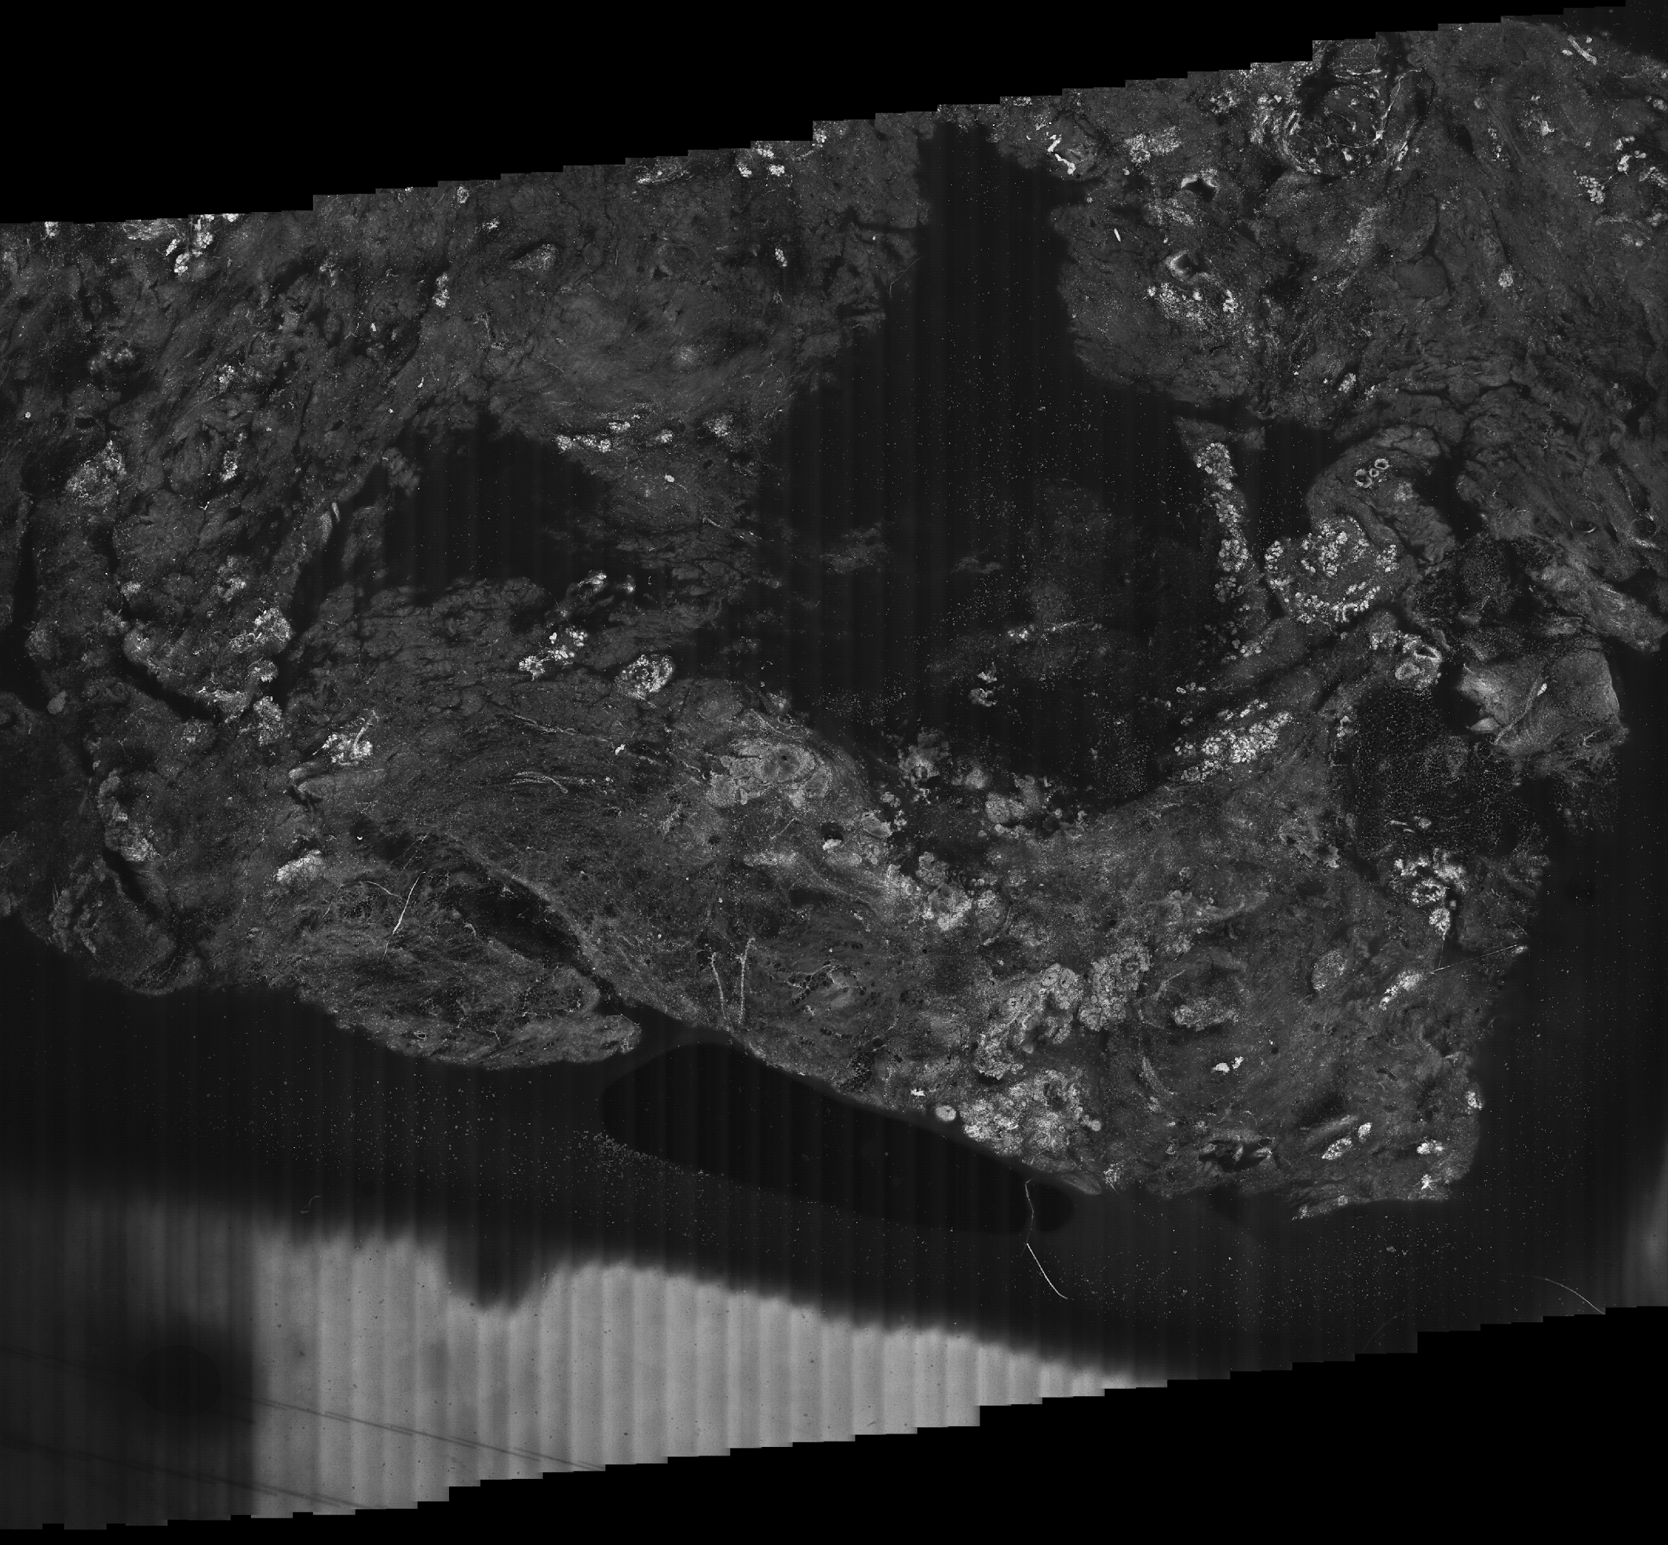
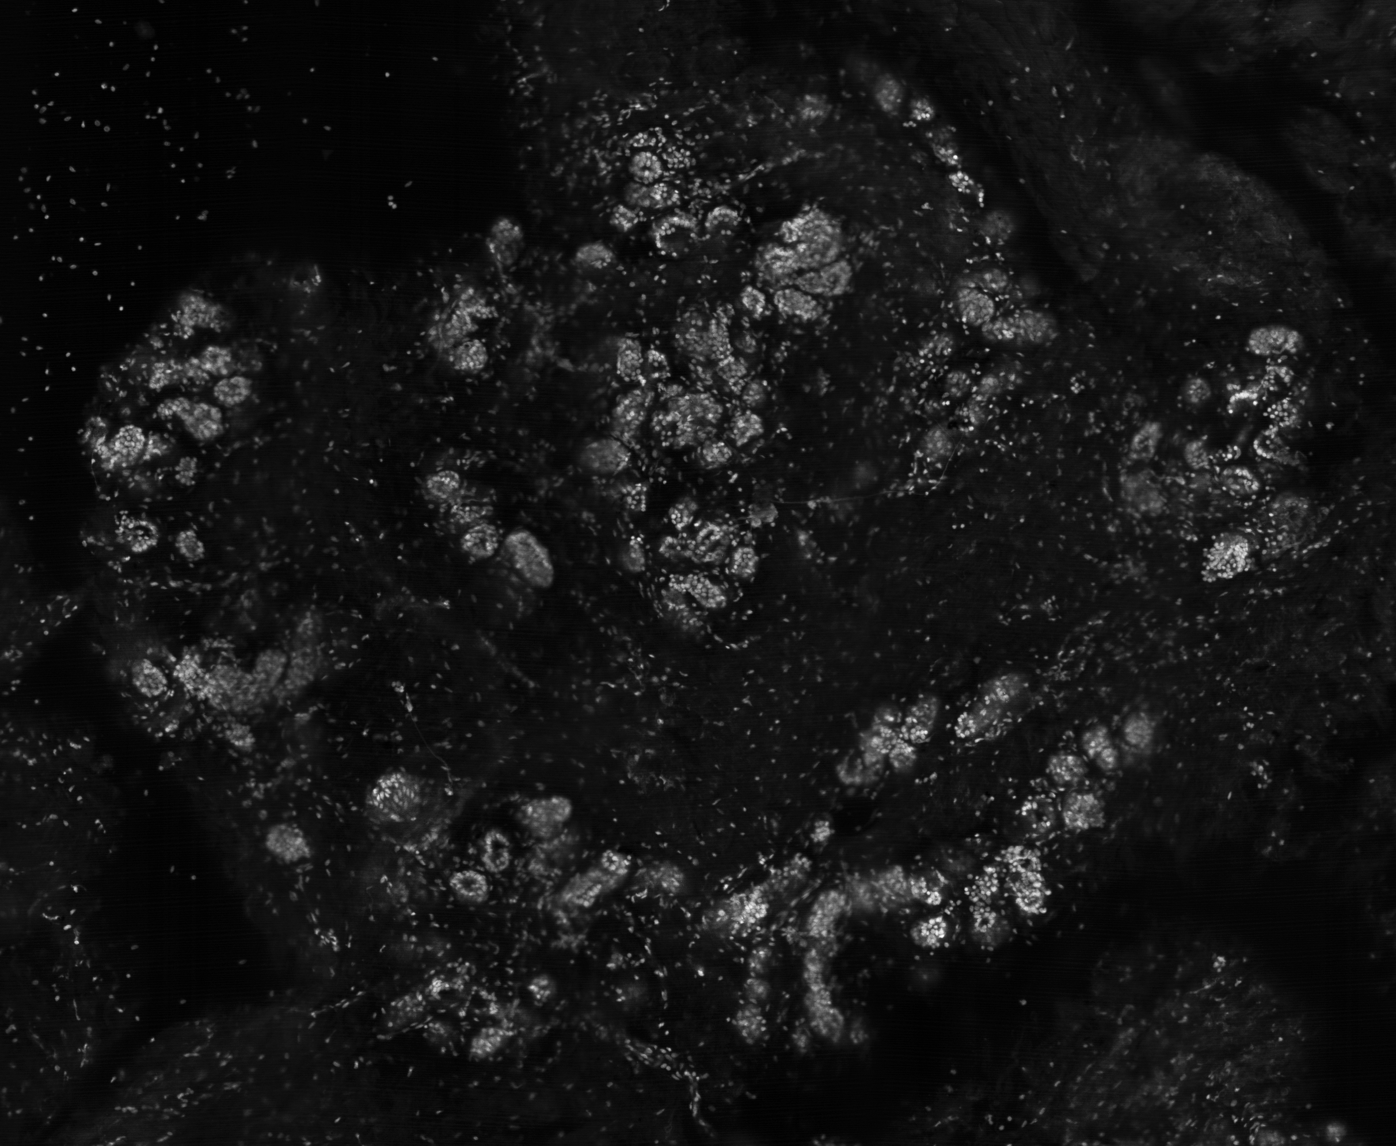
21mm
fluorescence mosaic
excised breast tissue
Breast Fibroadenoma in lobule
ducts
fibrous tissue
(stroma)
53 strips
ducts
breast lobules
fat cells
16 mm
stained in 0.6 mM of acridine orange for 60 sec
Notes:
‹#›

Slide 27
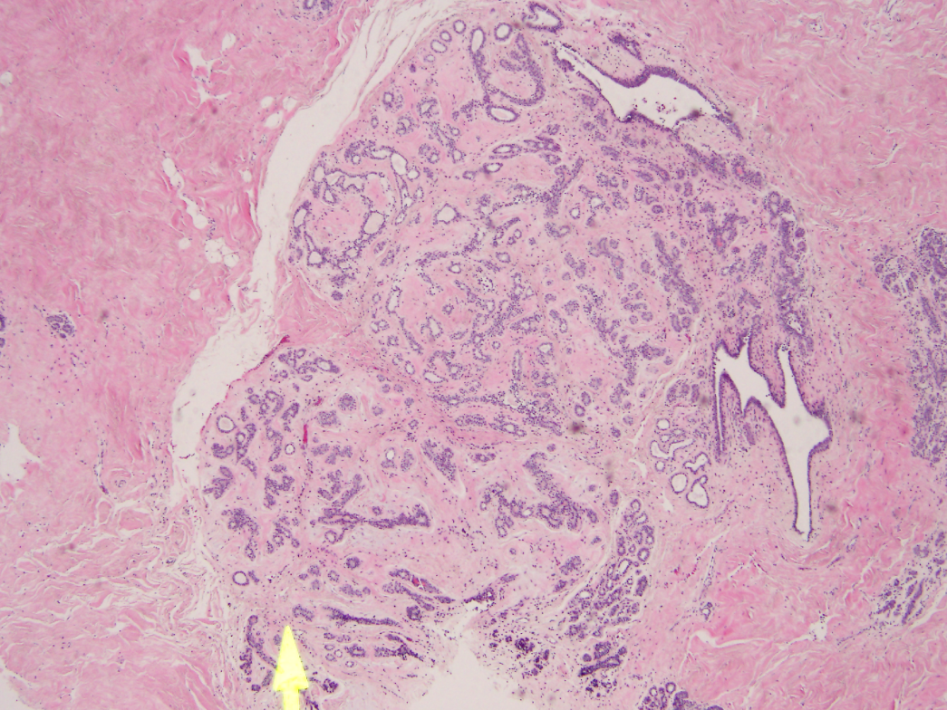
Breast Fibroadenoma – ducts (black and yellow arrows) are compressed due to excess fibrous tissue surrounding them (stroma)
A breast lobule
Histopathology
4x view
Mosaic
Notes:
‹#›

Slide 28
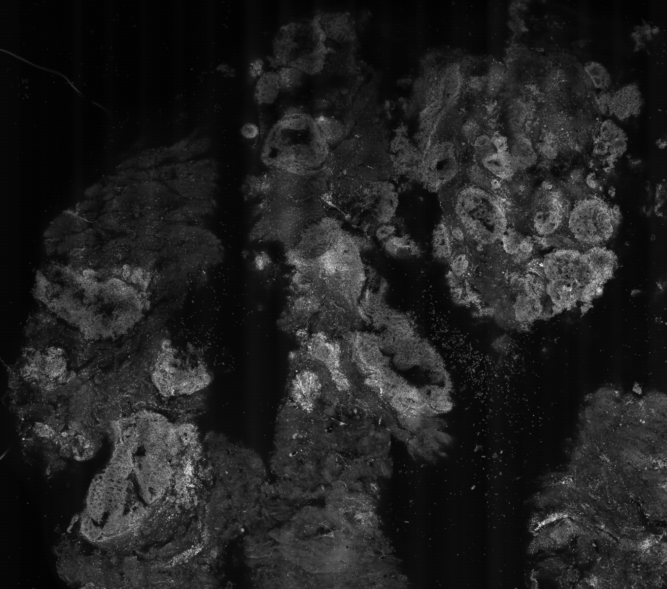
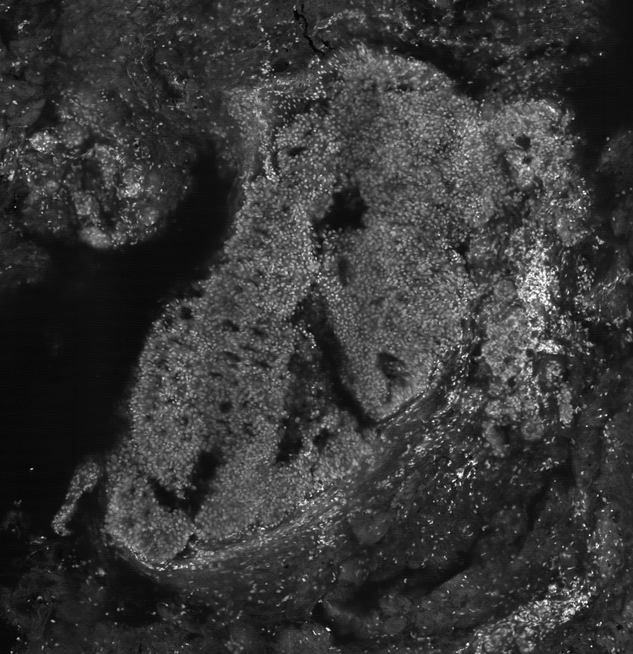
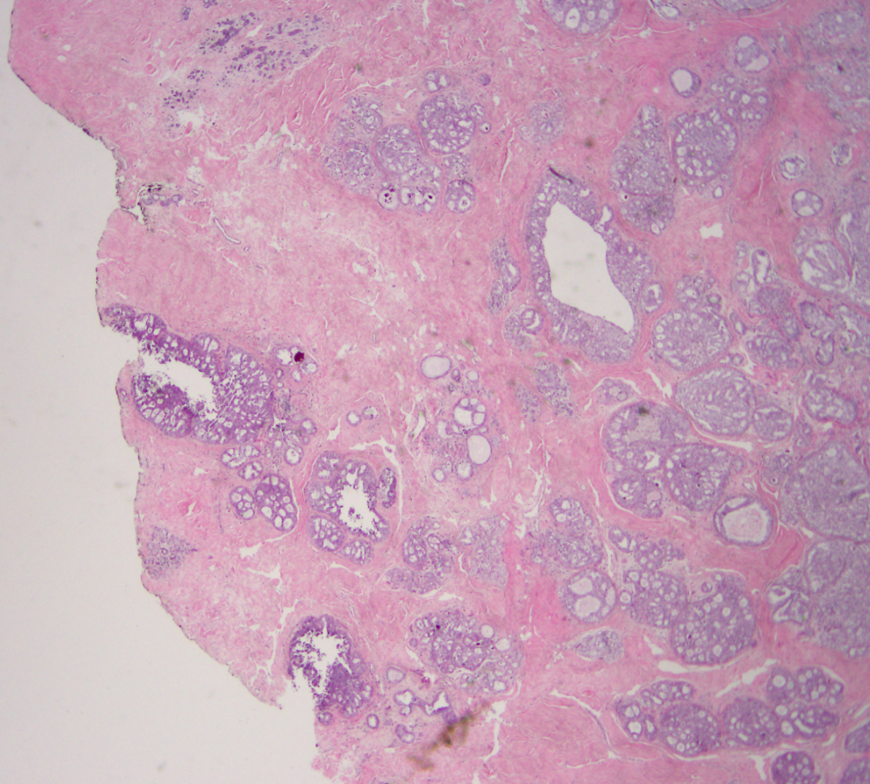
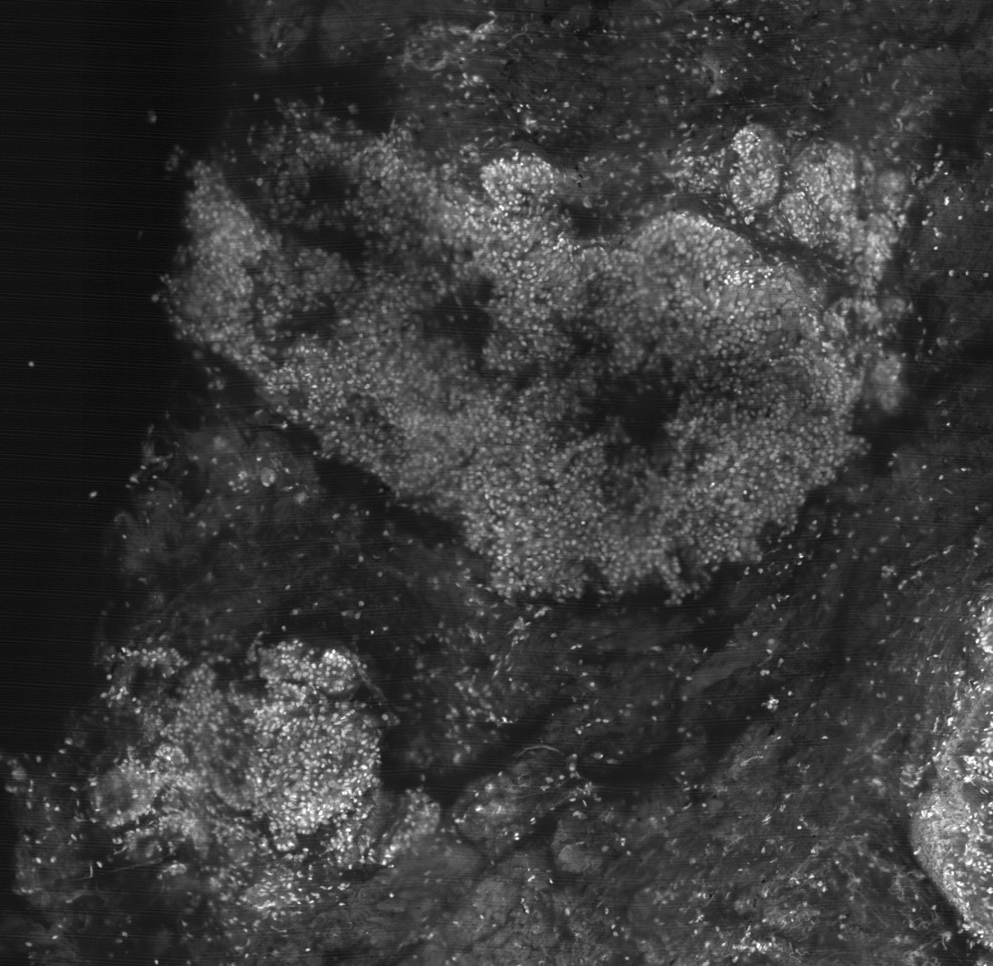
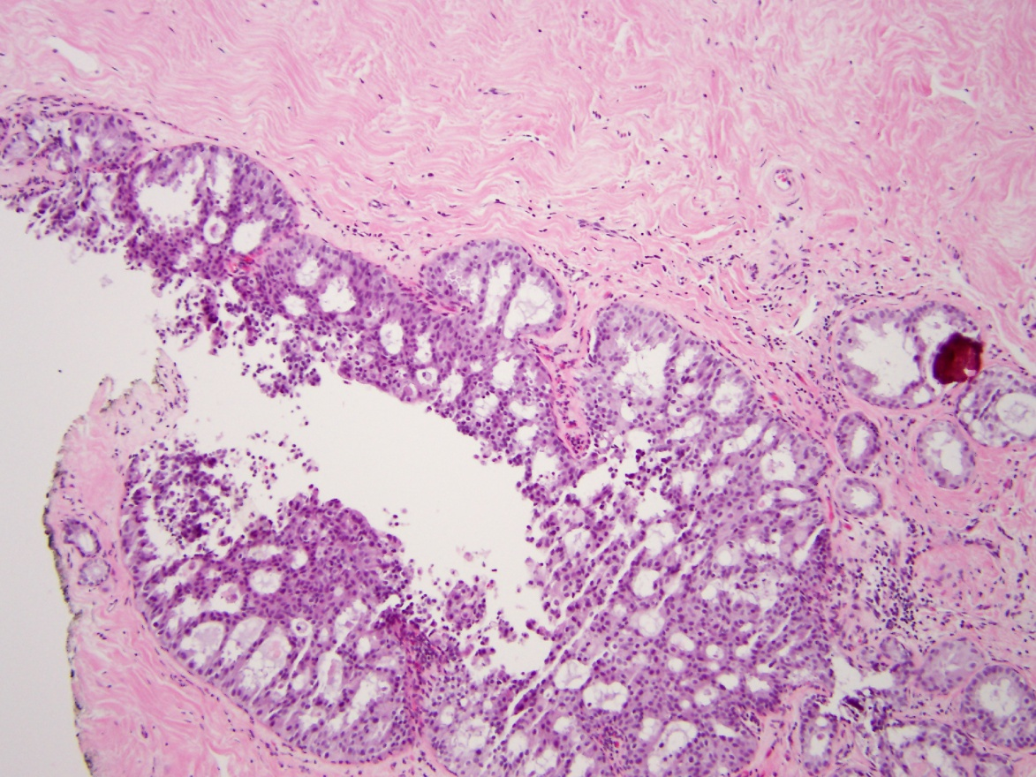
Ductal Carcinoma In-Situ (DCIS)
stained in 0.6 mM of acridine orange for 60 sec
A
histopathology
10x view
A
A
A
A
B
B
B
B
fluorescence mosaic
excised breast tissue
DCIS
in-situ
Histopathology
2x view
Notes:
‹#›

Slide 29
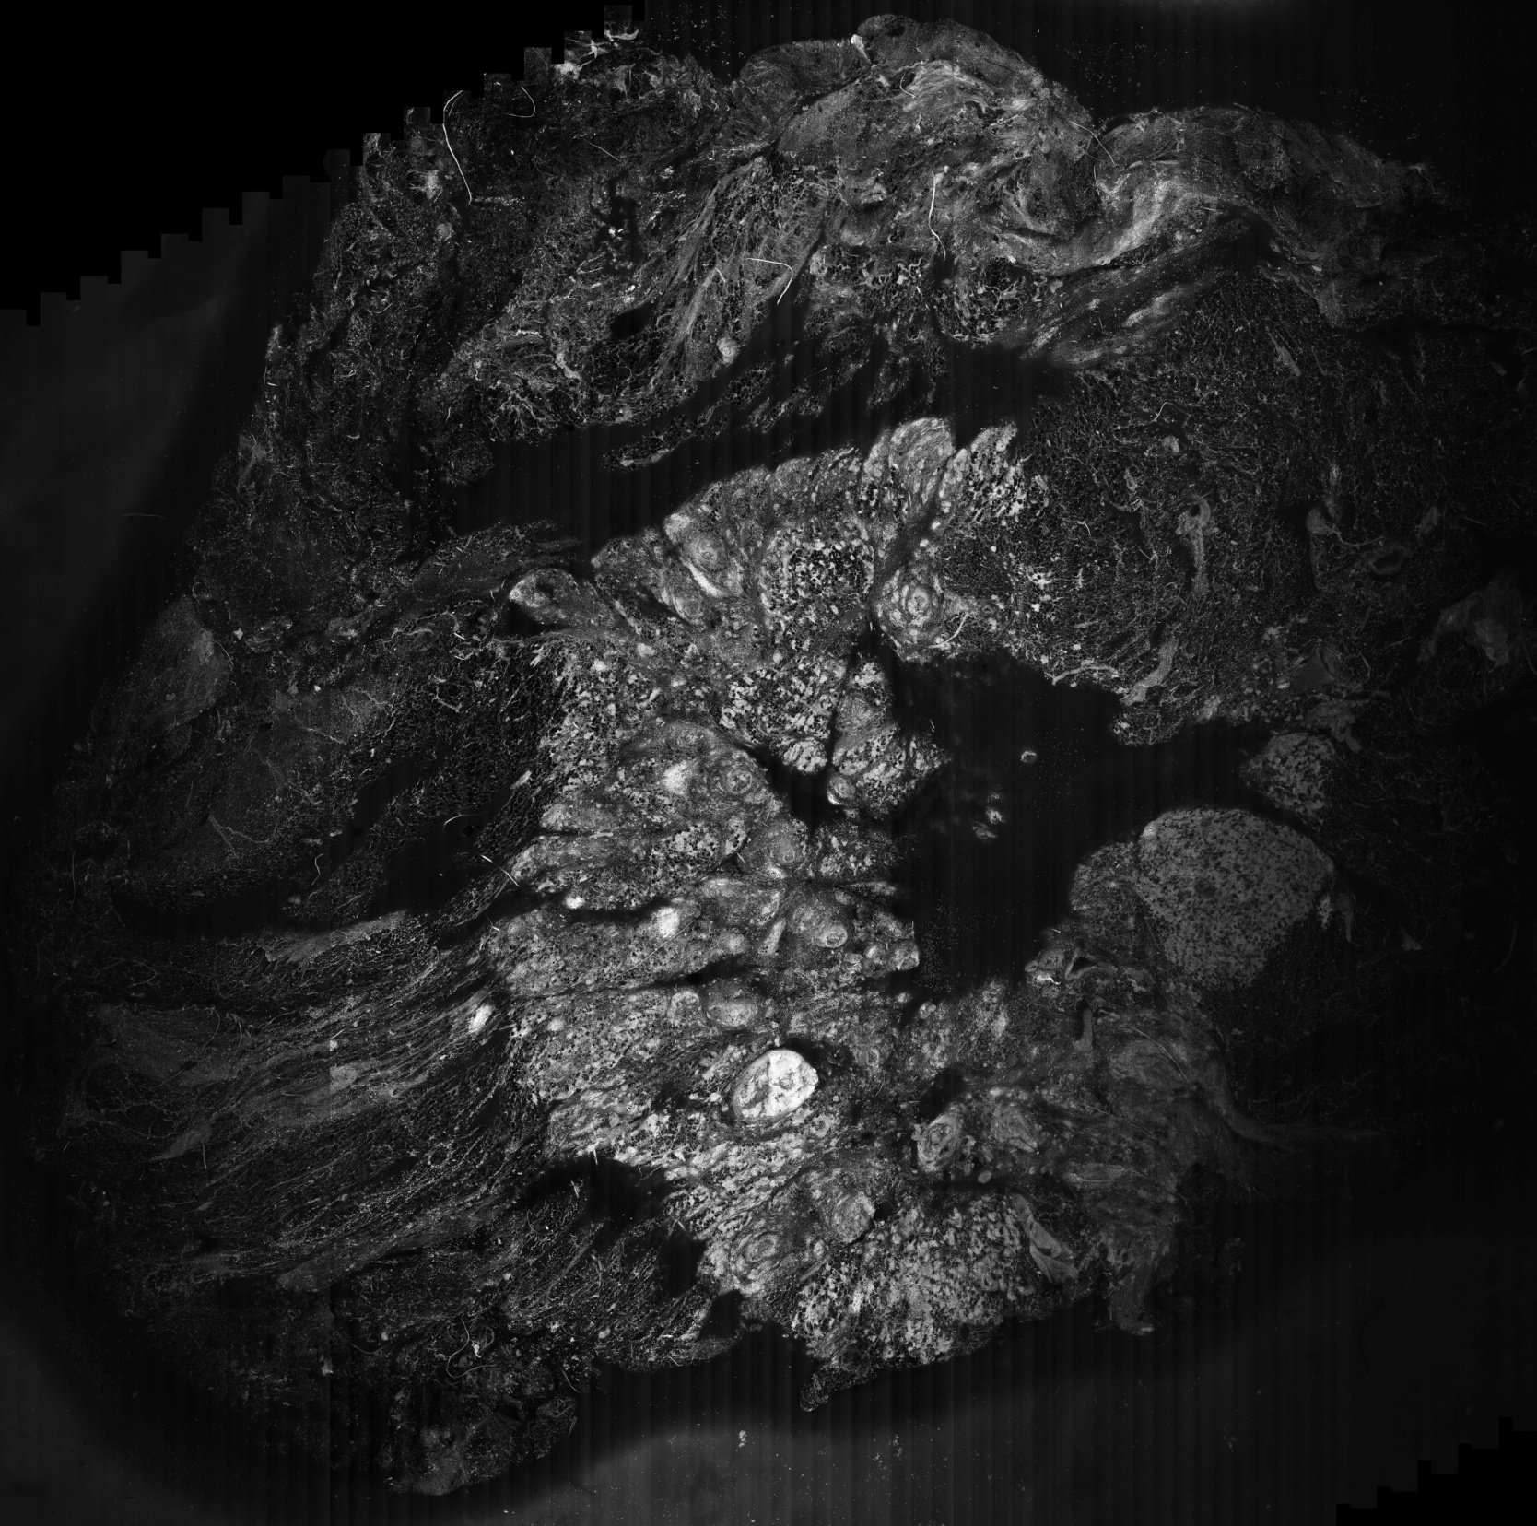
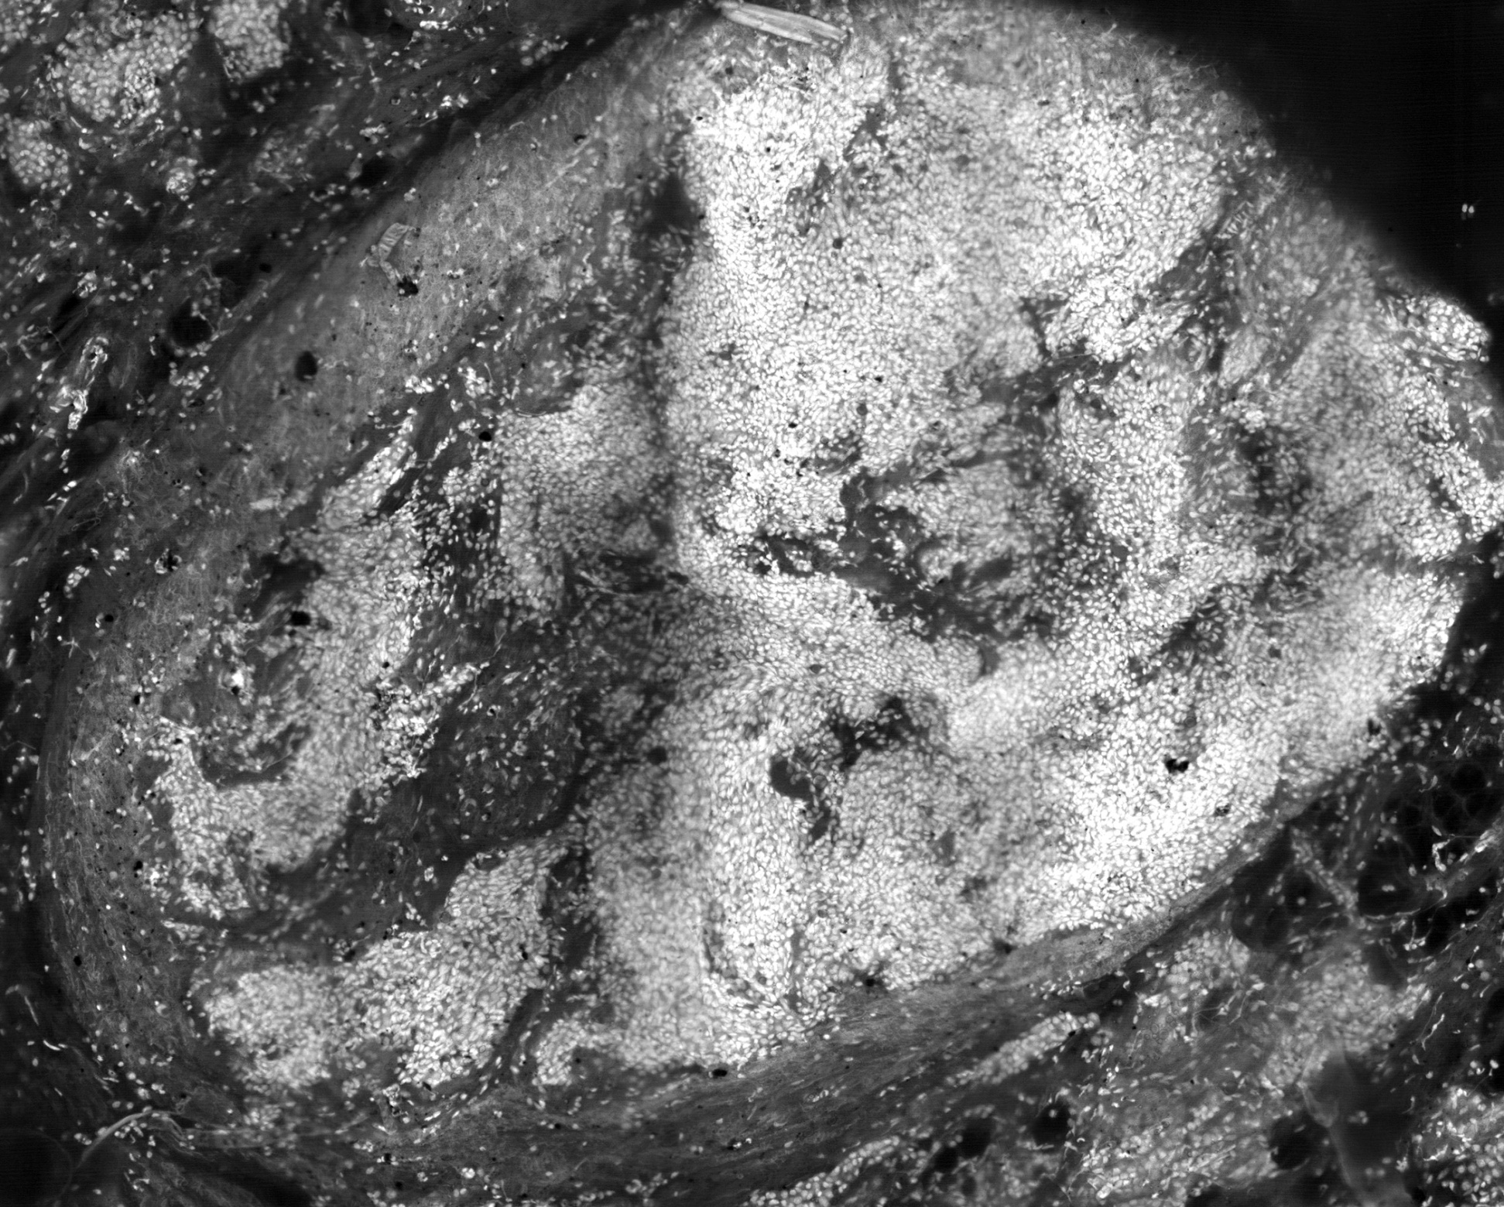
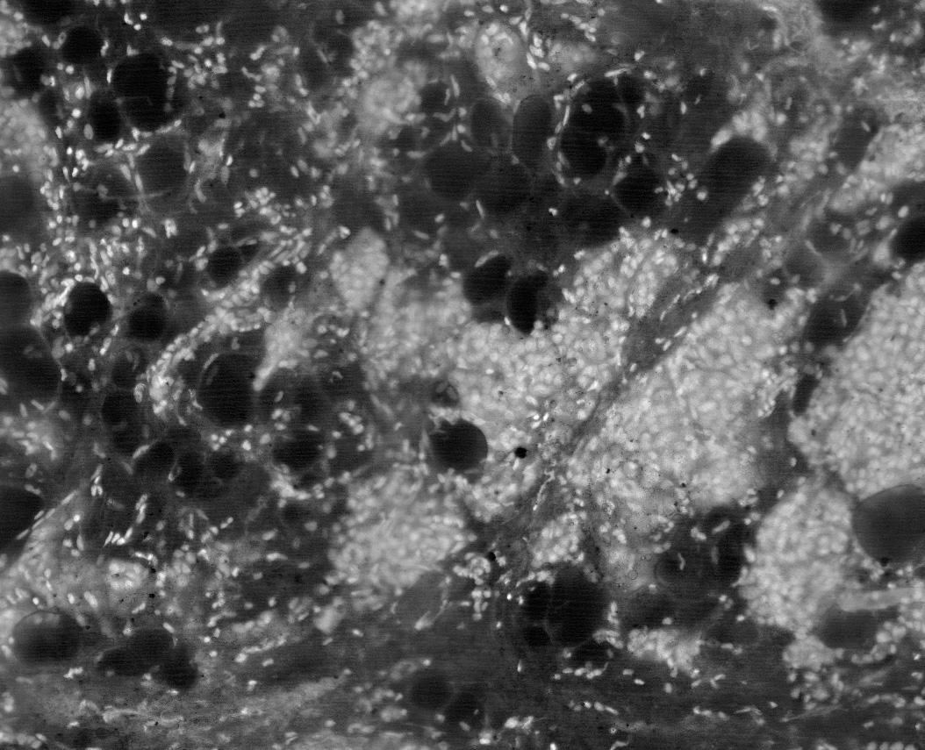
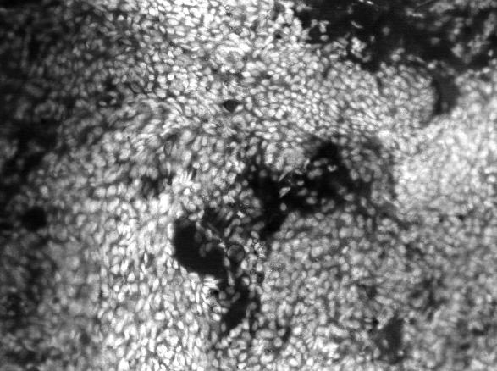
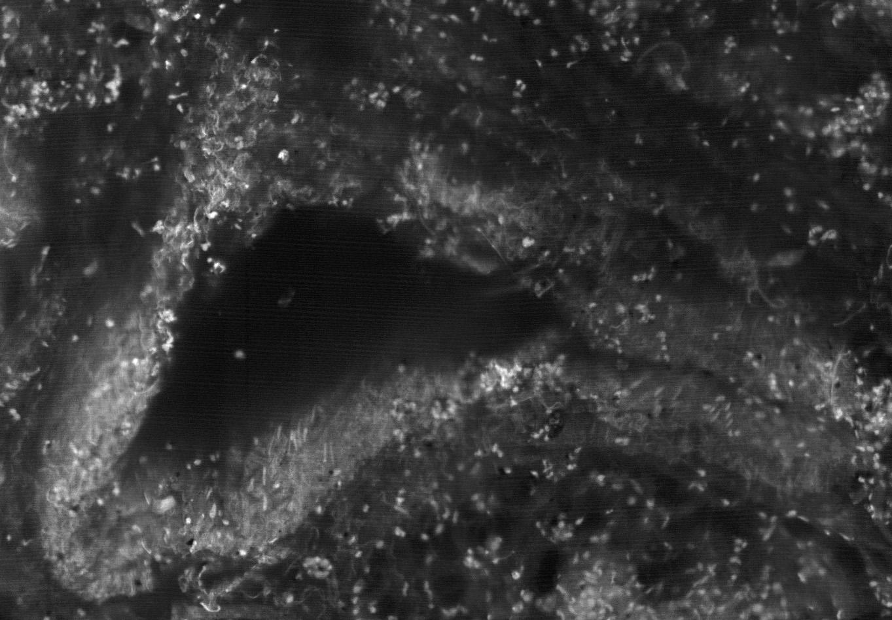
2.5 cm
JBO 2013. Vol18(6)
Breast Tissue
Fluorescence
Cellular morphology is important for pathology
85 strips
3.5 cm
Invasive cancer in fat cells
Breast duct with hollow lumen
Ductal Carcinoma In-Situ (DCIS)
Notes:
‹#›

Slide 30
Confocal Collaborators
Memorial Sloan-Kettering Cancer Center
Dr. Melissa Murray – pathology
Dr. Monica Morrow - surgery
Engineering Group:
Milind Rajadhyaksha – Head of Optical Eng. Group
Ricardo Toledo-Crow – Head of Eng. Group
Sanjee Abeytunge - electronics
Yongbiao Li - software
Chris Glazowski - optics
Gary Peterson – mechanical engineering
Eileen Flores – clinical imaging
This project funded by the NIH

Slide 31
Other optical techniques
Optical coherence tomography (OCT)
  It’s a Michelson interferometer!
  Resolution is 10-100 times better than MRI, CT, Ultrasound
OCT is routinely used for imaging the eye

Slide 32
Blood oxygenation
Current optical techniques give erroneous results in people with darker skin
The current tech uses spectroscopy to image the blood through the skin
  Oxygenated blood absorbs more infrared than deoxygenated blood
But if the melanin in the skin also has its own spectrum that affects the ratios of wavelengths absorbed, then racial bias is encoded into the blood ox reading
Solution: use polarization contrast instead of absorption contrast
lab of K. Touissant, Brown University

Slide 33
Optical trapping
Using light to manipulate small objects
Light carries momentum! And therefore can apply force.

Slide 34
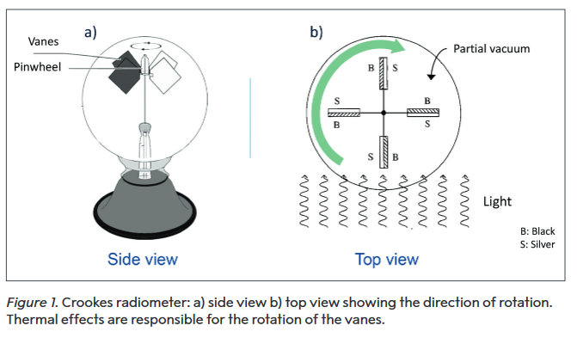
Crookes radiometer

Slide 35
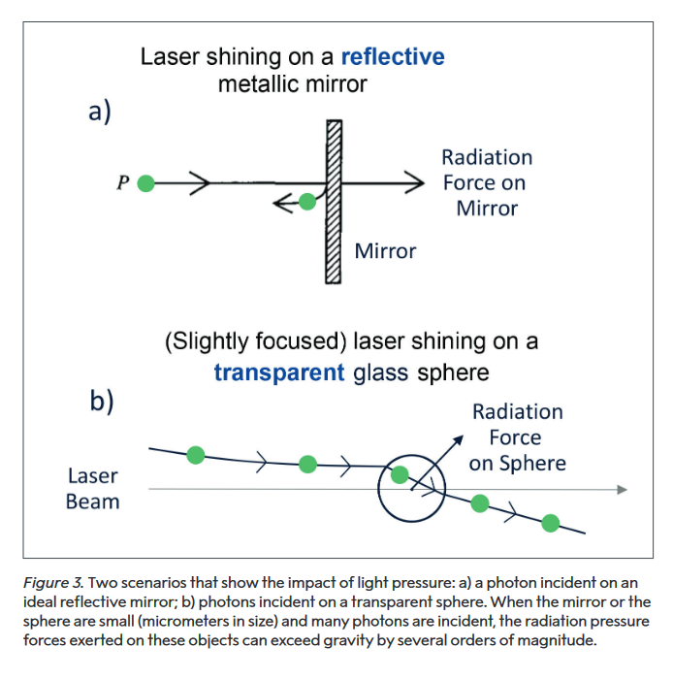
Light pressure:

Slide 36
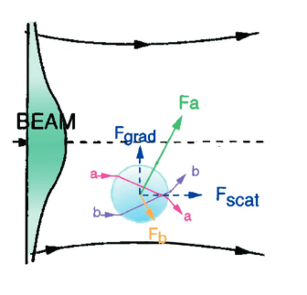
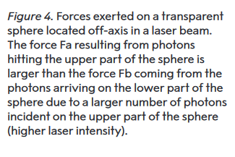
Gradient and Scattering forces

Slide 37
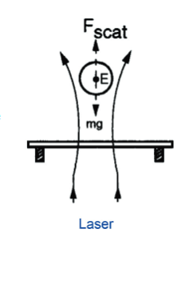
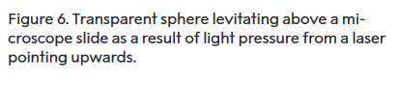
Optical levitation

Slide 38
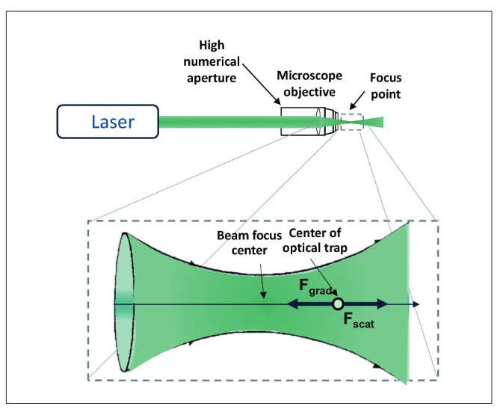

Single- beam optical trap

Slide 39
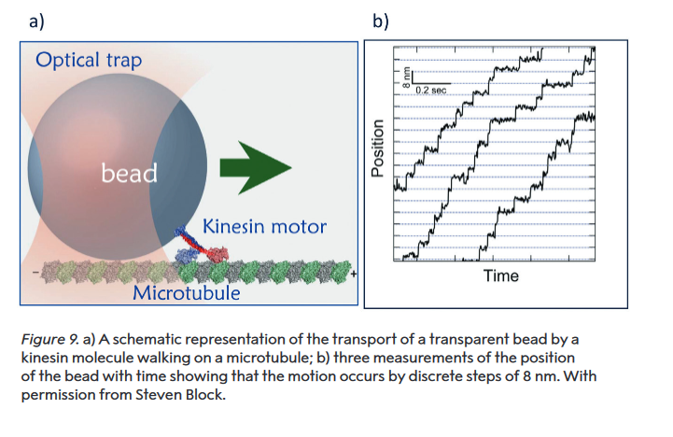
Kinesin motors
walking protein

Slide 40
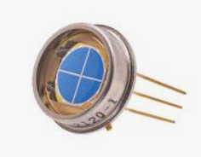
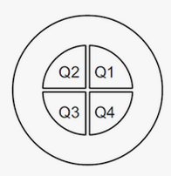
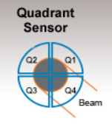
How do we measure displacement?
Quadrant
photodiode
X=(Q1+Q4)-(Q2+Q3)
Y=(Q1+Q2)-(Q3+Q4)
Z=Sum(Q)

Slide 41
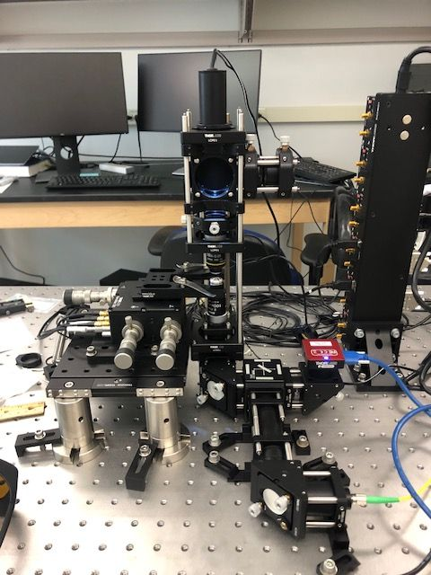
Tweezers setup: just a microscope!

Slide 42
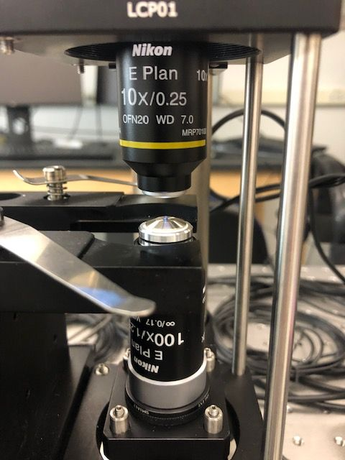
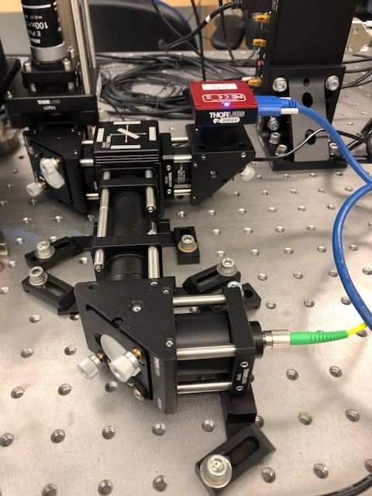
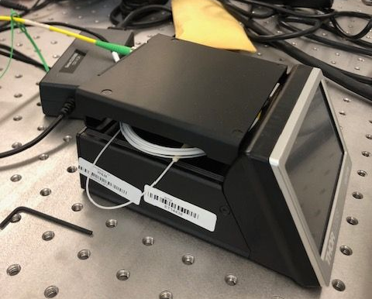

Slide 43
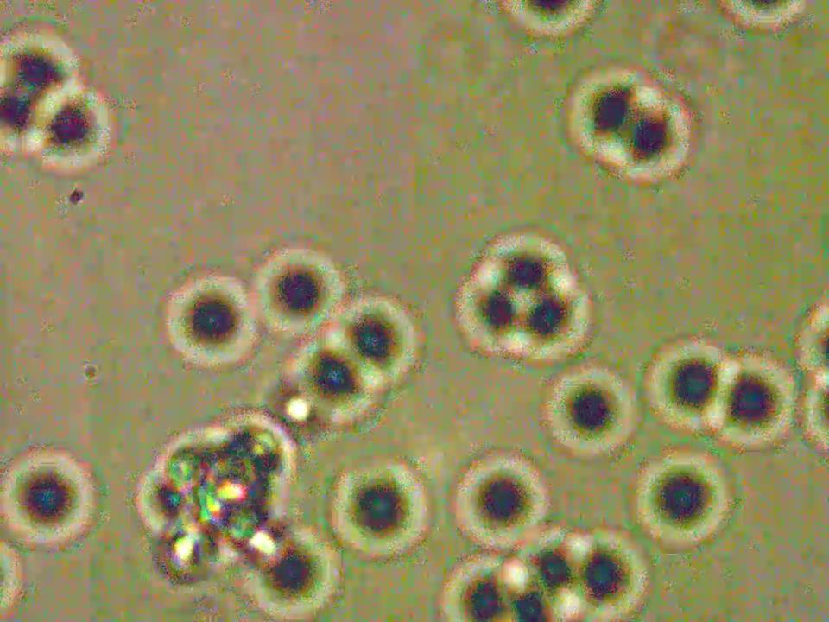

Slide 44
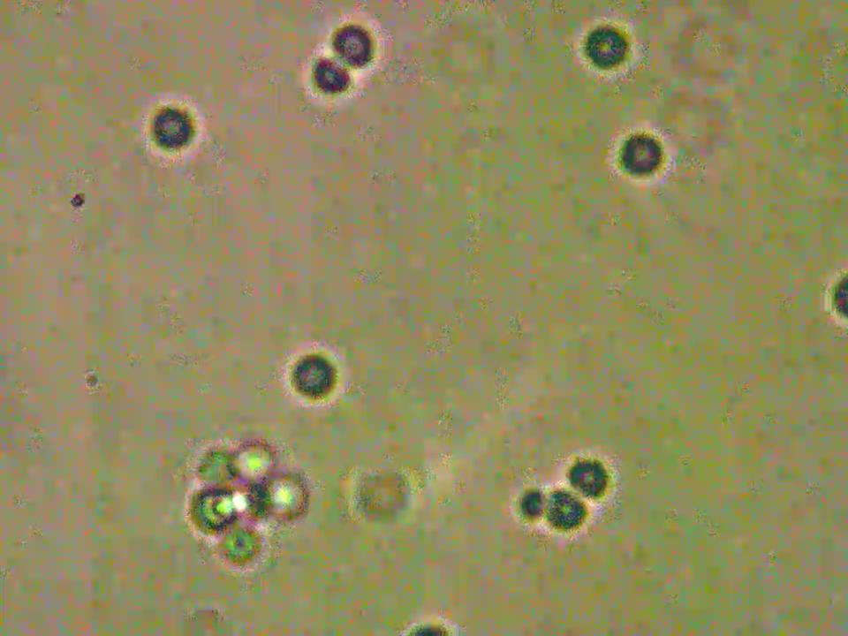

Slide 45


Slide 46
Thank you!
Optical Tweezers work is supported by the Higher Education Equipment Trust Fund (HEETF), and the W&M Faculty Research Grant

Slide 47
Other uses for confocal:
Confocal microscopes may enable
screening and diagnosis
guided-biopsy for pathology
pre-operative detection of cancer margins
intra-operative detection of cancer margins
surgical pathology-at-the-bedside
in vivo, ex vivo, real-time
minimize biopsy, pain, expense, time?

Slide 48

Structure of Epidermis
http://kreativestudios.com/Tooltip/05Integument/02epidermis.html

Slide 49


CONFOCAL IMAGES
En face sections
Parallel to skin surface
Basal cells at DE-junction
< 1 um lateral resolution
3-5 um axial sectioning
Reflectance or fluorescence contrast:
Acetic or citric acid whitening of nuclei
Acridine orange, methylene blue…
In vivo or ex vivo imaging

Slide 50


Diagnosing melanoma in vivo
Guitera, Pellacani and Menzies, J Invest Dermatol., 2007, 2009, 2010
SENSITIVITY SPECIFICITY
CONFOCAL: 85-92% 84-69%
DERMOSCOPY: 62-91% 39-31%
20 Pathologists: 87% (55-100%) 94% (83-100%)
Dermatopathologists: 90.4% 86.5%
www.lucid-tech.com
351 DERMOSCOPIC EQUIVOCAL lesions

Slide 51







Diagnosing basal cell carcinoma in vivo
Nori & Gonzalez, J. Amer. Acad. Dermatol., 2004; Gonzalez & Tannous, J. Amer. Acad. Dermatol., 2002
Sensitivity - 92%, specificity - 97%
elongated nuclei, monomorphic nuclei
polarized (highly oriented) nuclei
pleomorphic, basaloid epidermis
increased vascularity, inflammatory infiltrates in dermis

Slide 52
Detection of skin cancer margins in Mohs excisions with high-speed strip mosaicing confocal microscopy: a feasibility study
B. Larson,^{1,*} S. Abeytunge,² E. Seltzer,³ M. Rajadhyaksha,¹ and K. Nehal¹
British Journal of Dermatology, (2013) 169: 922–926. doi: 10.1111/bjd.12444

