Slide 1
Infrared spectroscopy of collective quantum phenomena
Mumtaz Qazilbash
Department of Physics
College of William and Mary

Slide 2
Outline
Condensed Matter Physics
New phenomena in many-particle systems
Methods in infrared and optical spectroscopy
Near-field infrared microscopy of inhomogeneous systems
Summary of my research

Slide 3

Condensed Matter Physics In Perspective
Atomic, Molecular, Optical Physics
Many interacting tiny objects
Gigantic objects
Cosmology
Condensed Matter Physics (high density)
Astrophysics
General relativity
Many-body quantum statistics
Physics
Isolated tiny objects
Elementary particle physics
Nuclear physics
Quantum fields

Slide 4
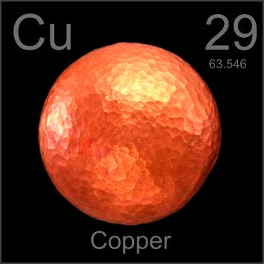
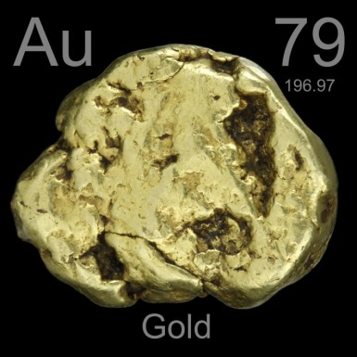
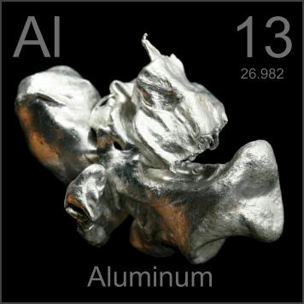
Many quantum particles in a solid
How many is “many” ?
> 10¹⁰ atoms/electrons
Many-particle physics leads to “emergent phenomena”
Collective behavior distinct from single particle properties
Examples
Color
Superconductivity
Electrons pair up and form a condensate that flows without resistance
ρ
Magnetism: Self-organization of electron spins
e.g. Pb, Sn, Al
Ferromagnetism
(Iron, Cobalt, Nickel)
T_{c}
T

Slide 5
Many weakly interacting quantum particles
Conventional metals eg. Au, Al, Cu, Ag……. have mobile carriers
Band insulators and semiconductors eg. diamond, silicon, rock salt… have localized charges
E
E
k
k
ρ
ρ
T
T

Slide 6
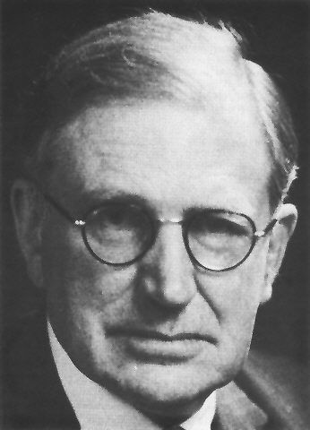
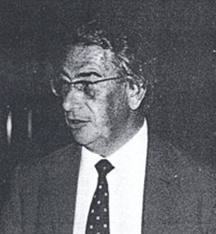
Mott (Correlated) Insulators
-
-
-
-
-
+
+
+
+
+
a
Screened Coulomb attraction
N. F. Mott
Nobel Laureate
-
-
-
-
-
+
+
+
+
+
a
Hubbard intra-atomic energy
J. Hubbard

Slide 7
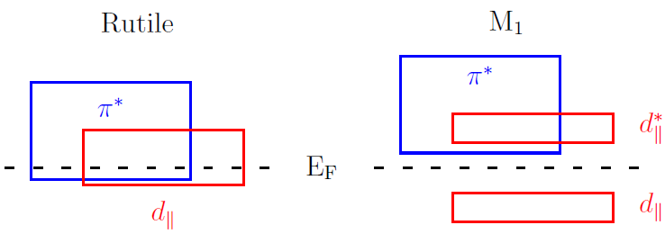
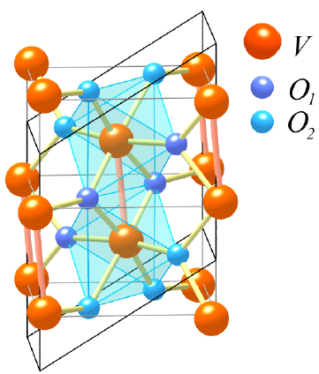
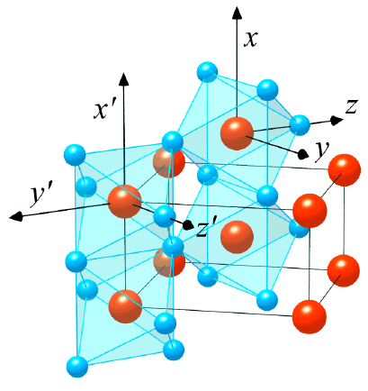
First Order Metal-insulator Transition in VO₂
Resistance Ω
10⁵
Band diagram
Insulator
10⁴
10³
10²
Metal
10
Nature of the energy gap ?
V-V dimerization (Peierls instability)
Electronic correlations (Mott physics)
(K)
Monoclinic M₁ insulator
Rutile metal
V. Eyert, Ann. Phys. (Leipzig) 11, 650 (2002)

Slide 8
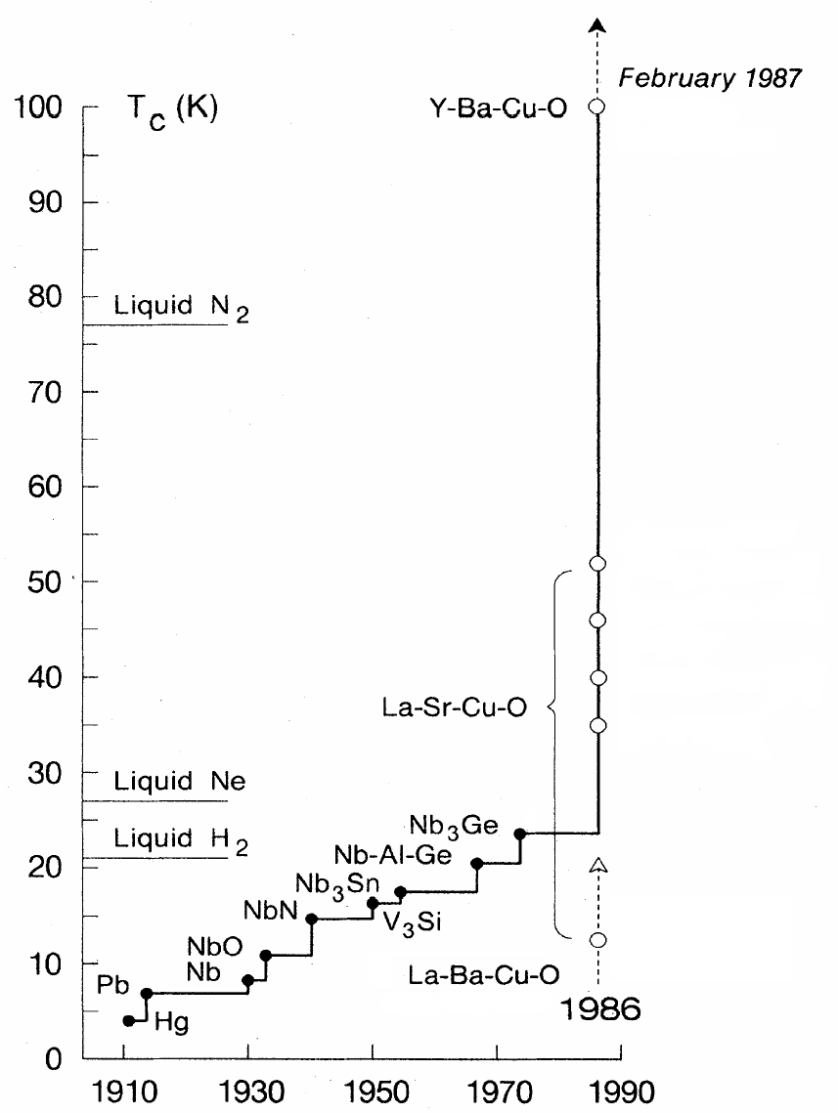
A brief history of superconductivity
BCS theory (1956-57)
SmO_{1-x}F_{x}FeAs (2008)
GL theory (1950)
MgB₂ (2001)
LaO_{1-x}F_{x}FeAs (2008)
FeSe_{x}Te_{1-x} (2009)
LaFePO
2006
Kammerlingh Onnes discovers superconductivity in Hg in 1911
Bednorz & Muller, Rev. Mod. Phys. 60, 585 (1988)

Slide 9
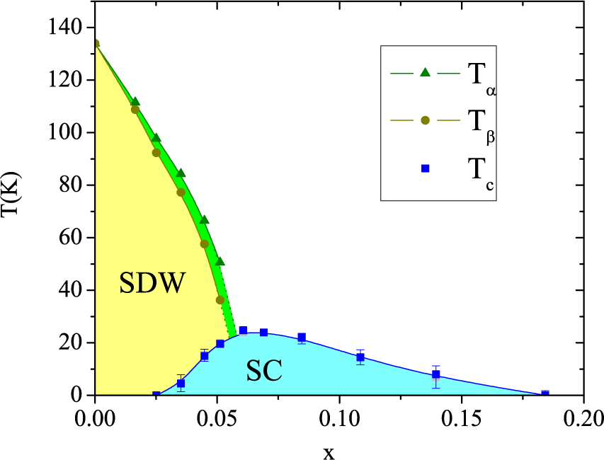
Cuprates and the iron pnictides
Cuprate phase diagram
122-Arsenides
Temperature
Ba(Fe_{1-x}Co_{x})₂As₂
antiferromagnet
T*
correlated metal
150 K
Correlated metal ?
Mott insulator
superconductor
0
doping
J. H. Chu et al., arXiv:0811.2463
Is the normal state of the pnictides also correlated ?

Slide 10
Infrared optics
Infrared
Visible
UV
Magnetic
res.
Magnetic modes in split ring resonators
AF resonances
III-V II-VI
FM resonances
2D electron gas: EF
2D gas
2D electron gas: plasmons
Spin-orbit coupling
Cyclotron modes and Landau Level transitions
Correlated
Metals
Localization peaks in disordered conductors
Carrier lifetimes in metals and semiconductors
Zeeman splitting
phonons
Inter-band transitions
TMO
Superconducting gap
polarons
(pseudo)gap in cuprates
Charge transfer gap
Magnetic resonances
and strong coupling effects
Amplitude modes
(polymers)
π-π* transitions
(polymers)
Organics
Josephson plasmons
Correlation gaps in 1D conductors
Heavy
fermions
Heavy Fermion plasmons
bi-polarons
Hybridization gap
D.N.Basov and T.Timusk, Reviews of Modern Physics 77, 721 (2005)
S.V. Dordevic and D.N. Basov, Annalen der Physik 15, 545 (2006)

Slide 11
Infrared transmission and reflectance
Transmission
Reflectance
Broadband Infrared source
Broadband Infrared source
Infrared detector
Michelson interferometer
Michelson interferometer
sample
sample
Infrared detector
T (ω), R (ω)
ε₁(ω) + i ε₂(ω)

Slide 12



Ellipsometry
VO₂ film on Al₂O₃ substrate
Plane Of Incidence
Measure ellipsometric coefficients Ψ and Δ to obtain optical constants using appropriate model

Slide 13
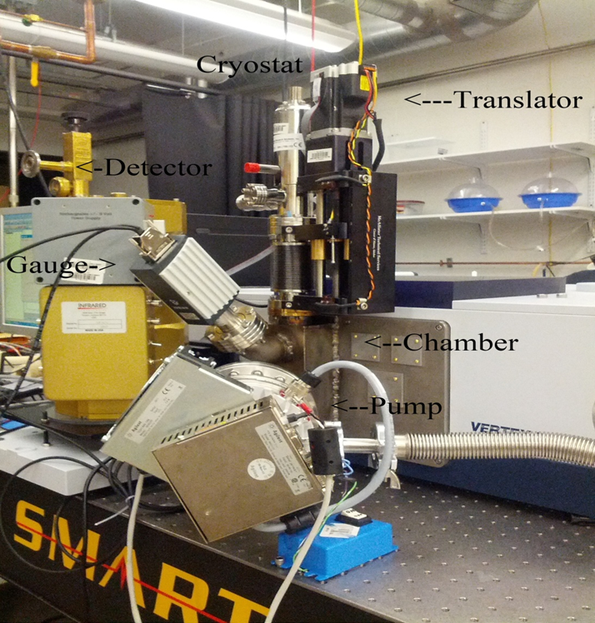
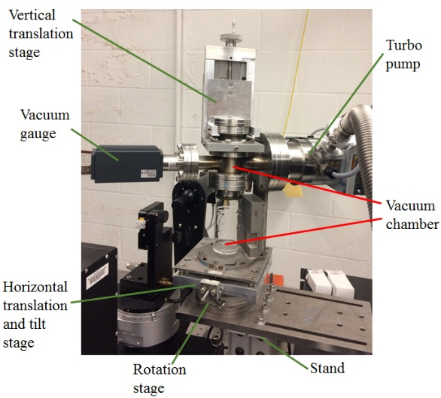
Some photos…….
Cryogenic infrared reflectance equipment
Cryogenic ellipsometry: near-infrared, visible, UV

Slide 14
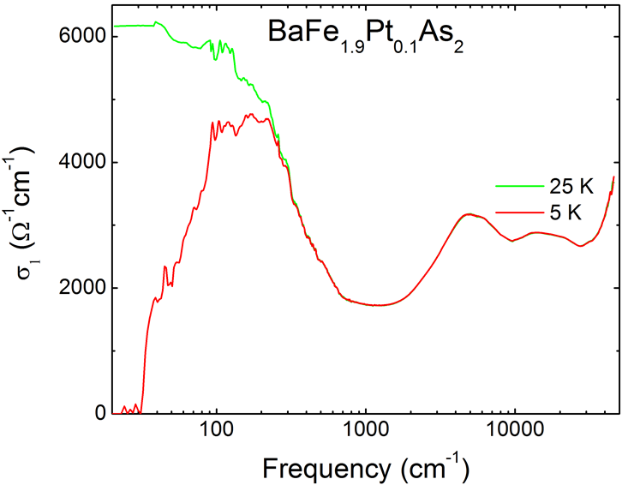
Optical conductivity and the superconducting gap
BCS s-wave superconductor
Iron-based superconductor
T > T_{c}
σ₁
T << T_{c}
0
2Δ
ν

Slide 15
VO₂ : Correlated insulator, strange metal
dR/dT > 0
dR/dT < 0
Rutile metallic
Monoclinic insulating
Nature of the metallic phase in the transition region ?
Changes in σ₁(ω) up to 6 eV
Mott physics
M. M. Qazilbash et al., PRB 74, 205118 (2006)

Slide 16
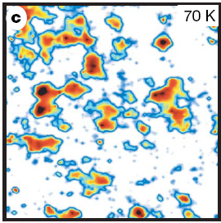
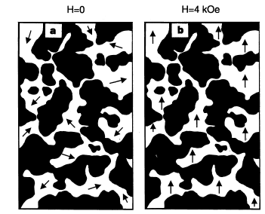
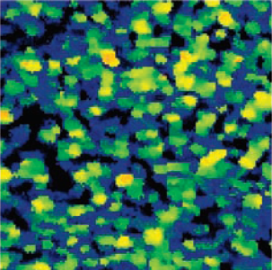
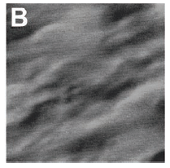
Intrinsic Inhomogeneities and Correlated Electron Matter
Cuprates: tunneling
Gomes et al., Nature 447, 569 (’07)
Over-doped Bi-2212
Manganites: el microscopy
M.Uehara, S.Mori, C.H.Chen, S.W.Cheong, Nature 399 560 (1999)
Δ (mV)
La_{5/8-y}Pr_{y}Ca_{3/8}MnO₃ (y=0.375)
50
λ_{IR}= 5-300 μm
: FM metal
: CO
insulator
0
30 nm
1 μm
Cuprates: tunneling
Lang et al. Nature 412, 415 (‘02)
Under-doped Bi-2212
Manganites: MFM
L.Zhang et al, Science 298 805 (‘02)
La_{5/8-y}Pr_{y}Ca_{3/8}MnO₃ (y=0.375)
Δ (mV)
65
CO
20
7.5 μm
FM
56 nm

Slide 17
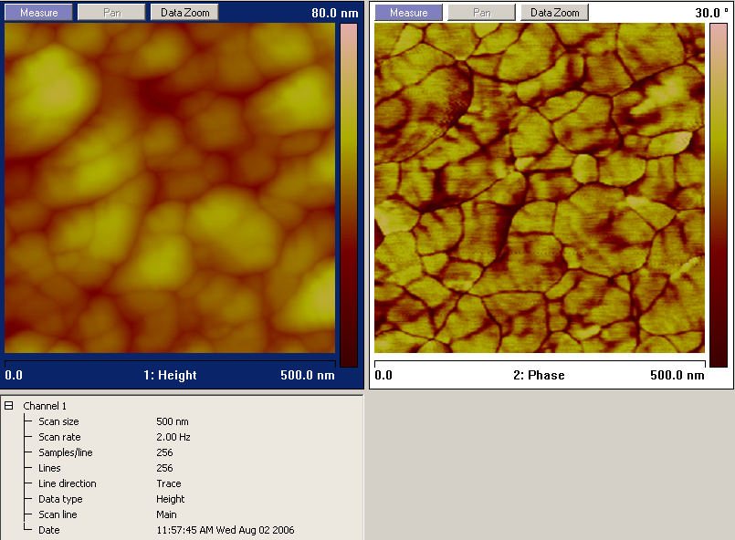
Infrared optics at the nano-scale
Scattering Near field IR
microscope (s-SNIM)
Tip
Magnetic
res.
Magnetic modes in split ring resonators
IR
AF resonances
III-V II-VI
FM resonances
2D electron gas: EF
2D gas
2D electron gas: plasmons
Spin-orbit coupling
Cyclotron modes and Landau Level transitions
Localization peaks in disordered conductors
Sample
Correlated
Metals
Carrier lifetimes in metals and semiconductors
mirror
dipole
Zeeman splitting
phonons
Inter-band transitions
TMO
Superconducting gap
polarons
(pseudo)gap in cuprates
Charge transfer gap
ε₁, ε₂
@ ω_{laser}
Magnetic resonances
and strong coupling effects
Amplitude modes
(polymers)
π-π* transitions
(polymers)
Organics
Spatial resolution ~ 20 nm
Josephson plasmons
Correlation gaps in 1D conductors
Heavy
fermions
Heavy Fermion plasmons
bi-polarons
IR
10.8 μm
Hybridization gap
D.N.Basov and T.Timusk Reviews of Modern Physics 77, 721 (2005)
S.V. Dordevic and D.N. Basov Annalen der Physik 15, 545 (2006)
F.Keilmann J. El. Micr. 53, 187 (2004)

Slide 18
Infrared optics at the nano-scale
Scattering Near field IR
microscope (s-SNIM)
Tip
Magnetic
res.
Magnetic modes in split ring resonators
IR
AF resonances
III-V II-VI
FM resonances
2D electron gas: EF
2D gas
2D electron gas: plasmons
Spin-orbit coupling
Cyclotron modes and Landau Level transitions
Localization peaks in disordered conductors
Sample
Correlated
Metals
Carrier lifetimes in metals and semiconductors
mirror
dipole
Zeeman splitting
phonons
Inter-band transitions
TMO
Superconducting gap
polarons
(pseudo)gap in cuprates
Charge transfer gap
ε₁, ε₂
@ ω_{laser}
Magnetic resonances
and strong coupling effects
Amplitude modes
(polymers)
π-π* transitions
(polymers)
Organics
Spatial resolution ~ 20 nm
Josephson plasmons
Correlation gaps in 1D conductors
Heavy
fermions
Heavy Fermion plasmons
bi-polarons
IR
10.8 μm
Hybridization gap
D.N.Basov and T.Timusk, Reviews of Modern Physics 77, 721 (2005)
S.V. Dordevic and D.N. Basov, Annalen der Physik 15, 545 (2006)
F.Keilmann J. El. Micr. 53, 187 (2004)

Slide 19
Direct observation of inhomogeneity in VO₂
VO₂: from correlated insulator to exotic metal
IR nanoscopy @ 930 cm⁻¹
IR

Slide 20

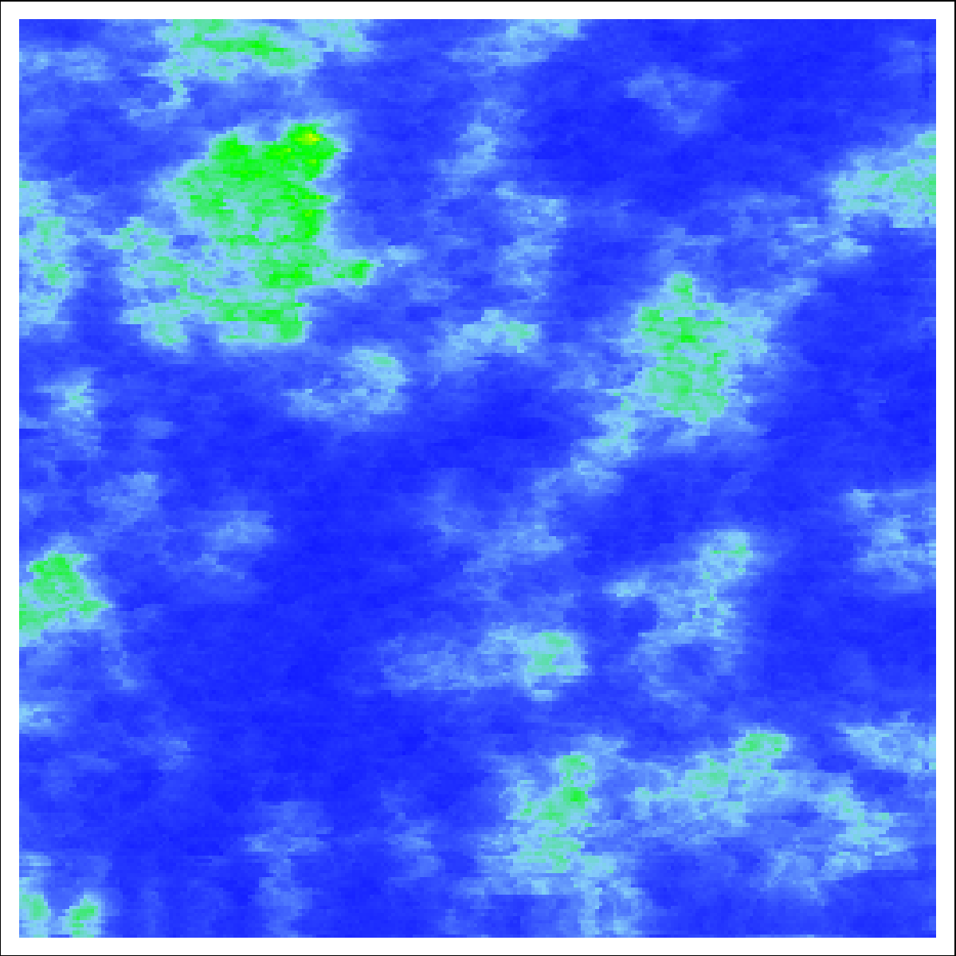
Direct observation of inhomogeneity in VO₂
IR nanoscopy @ 930 cm⁻¹
s²
1 10 20
ε₁
5 0 -5
T = 342.6 K
4 μm
20 nm
insulator
metal
IR

Slide 21


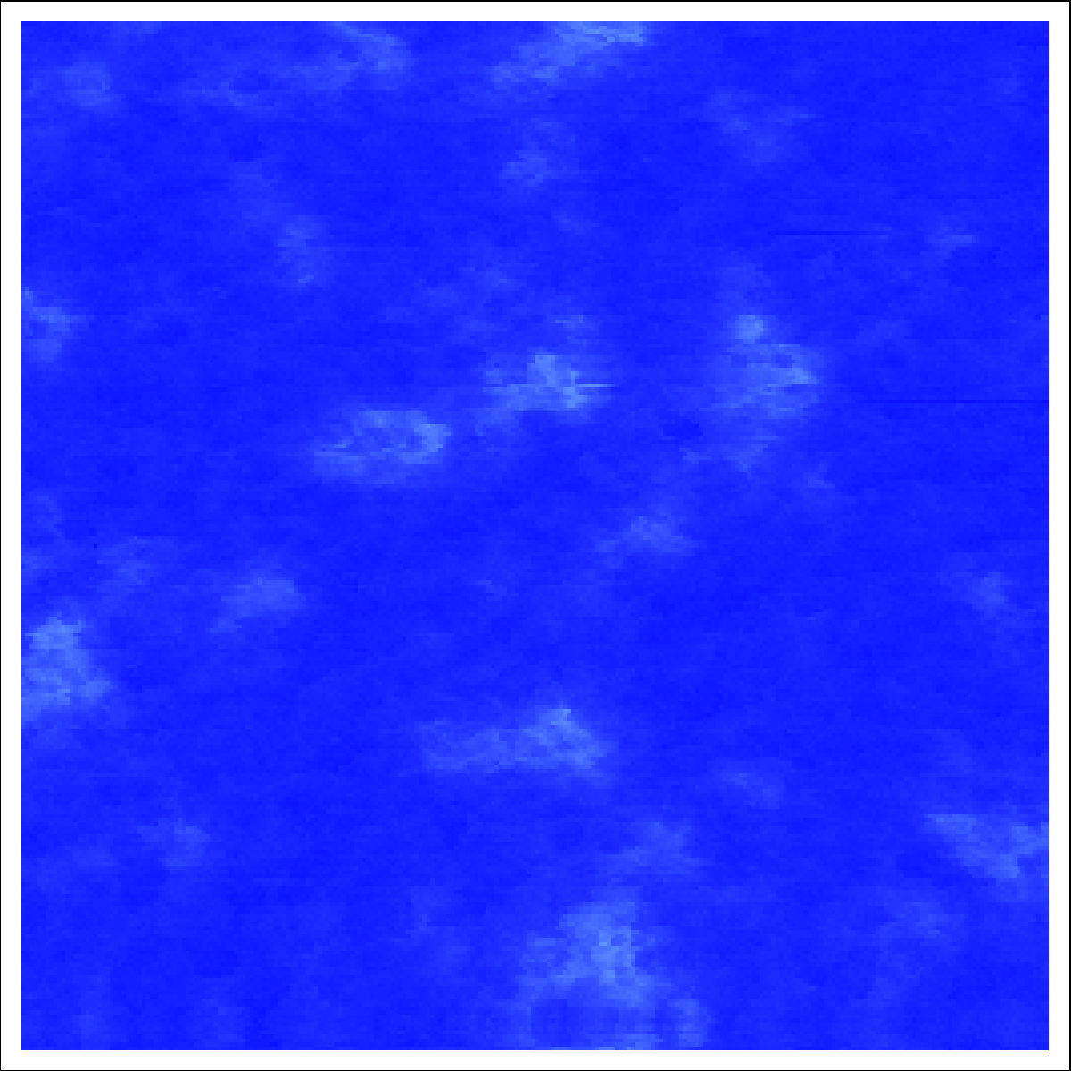
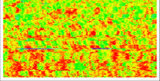


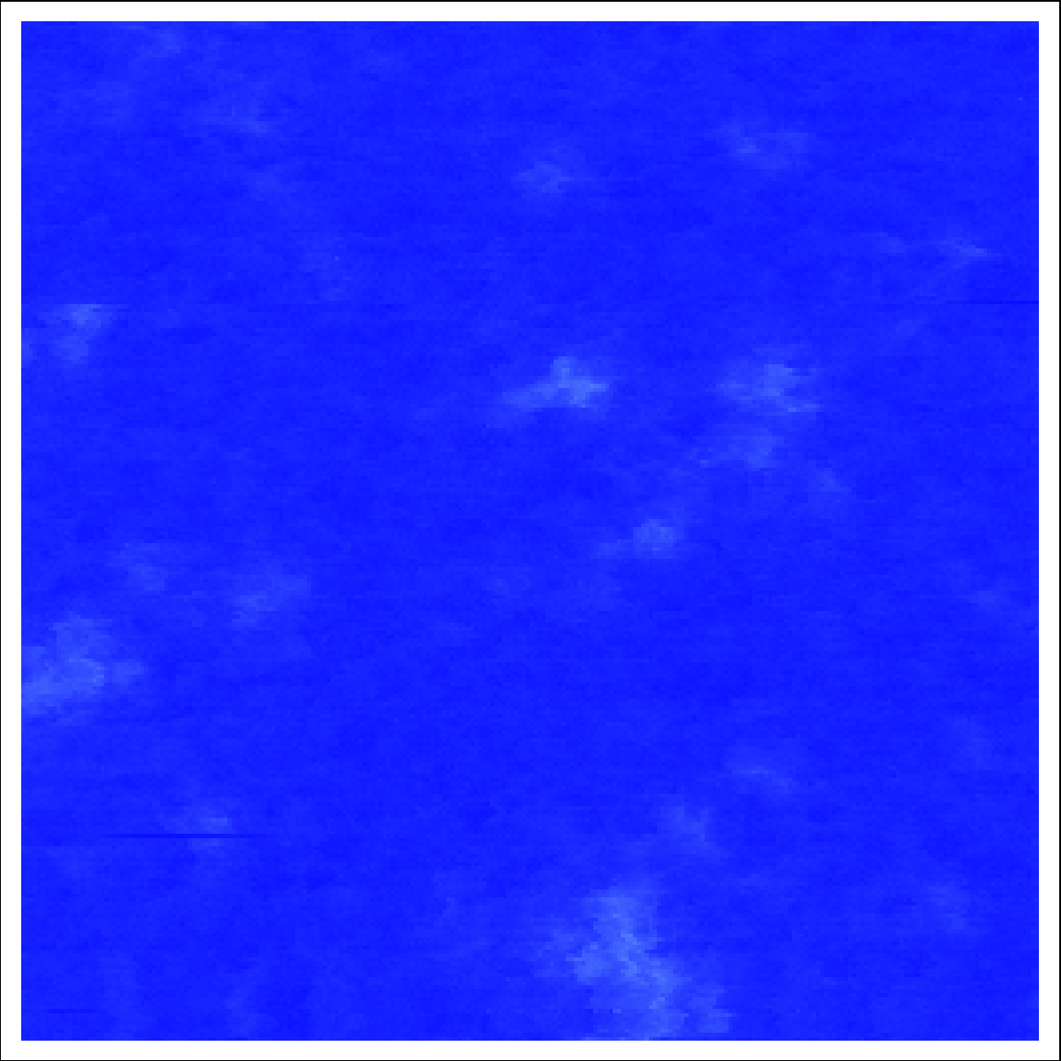


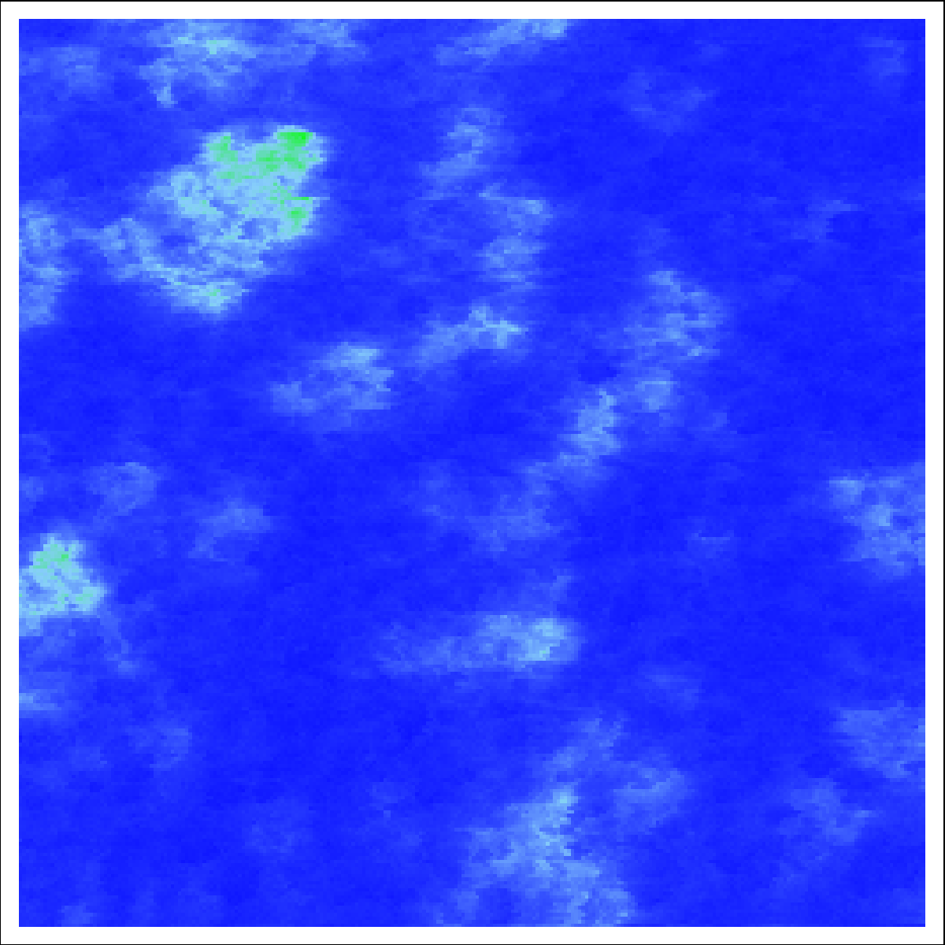
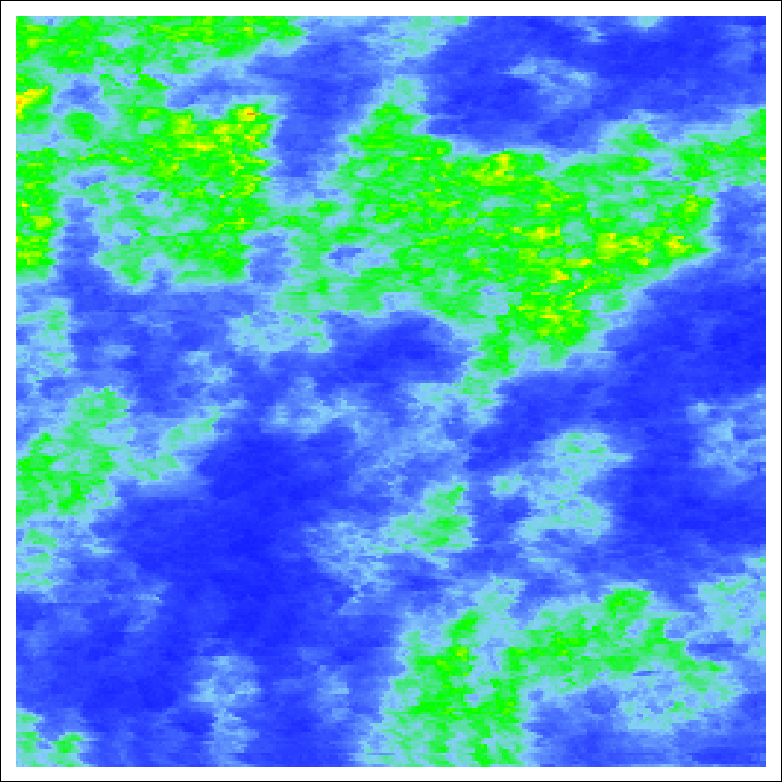
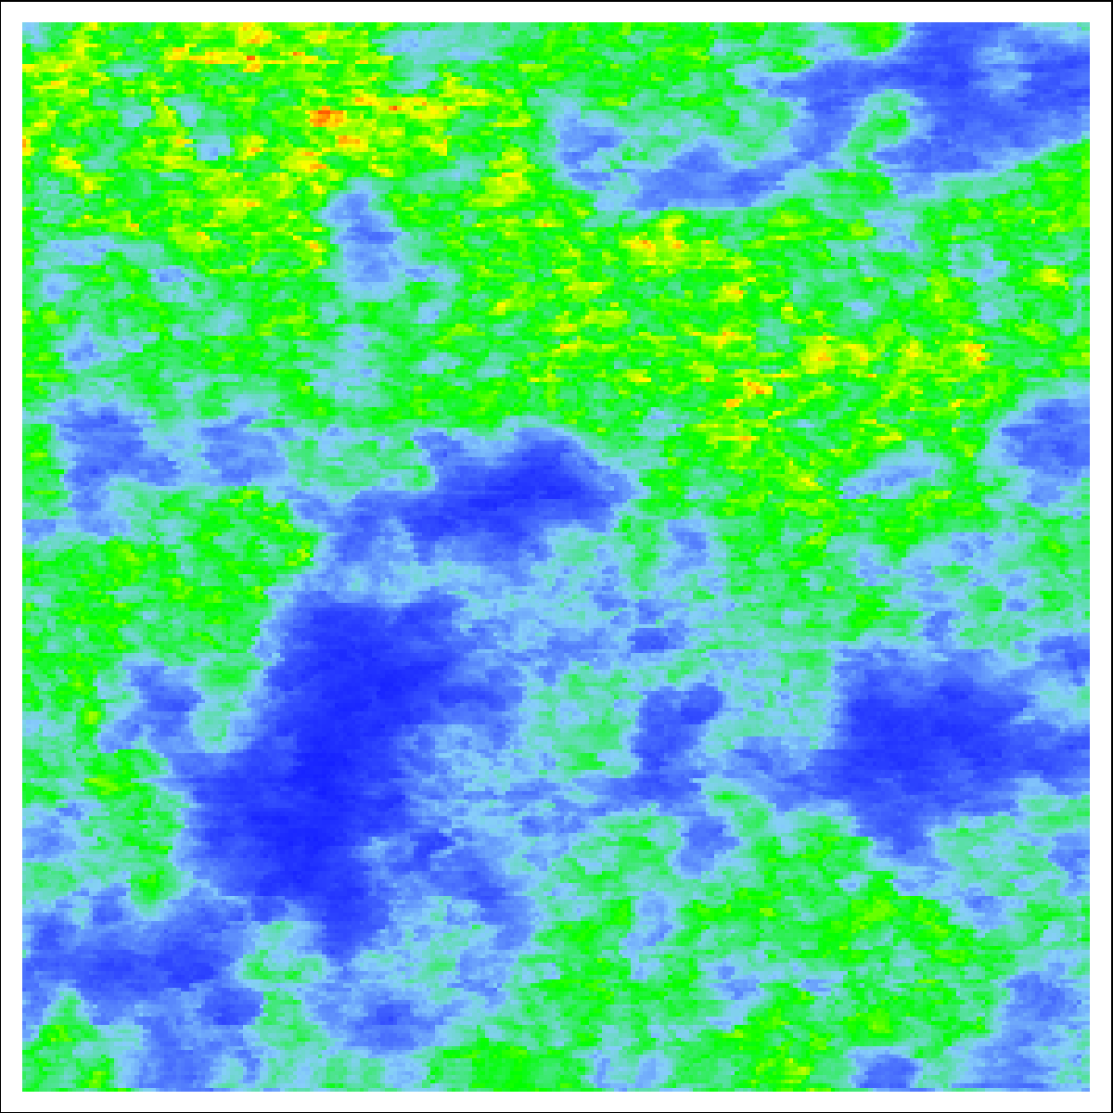
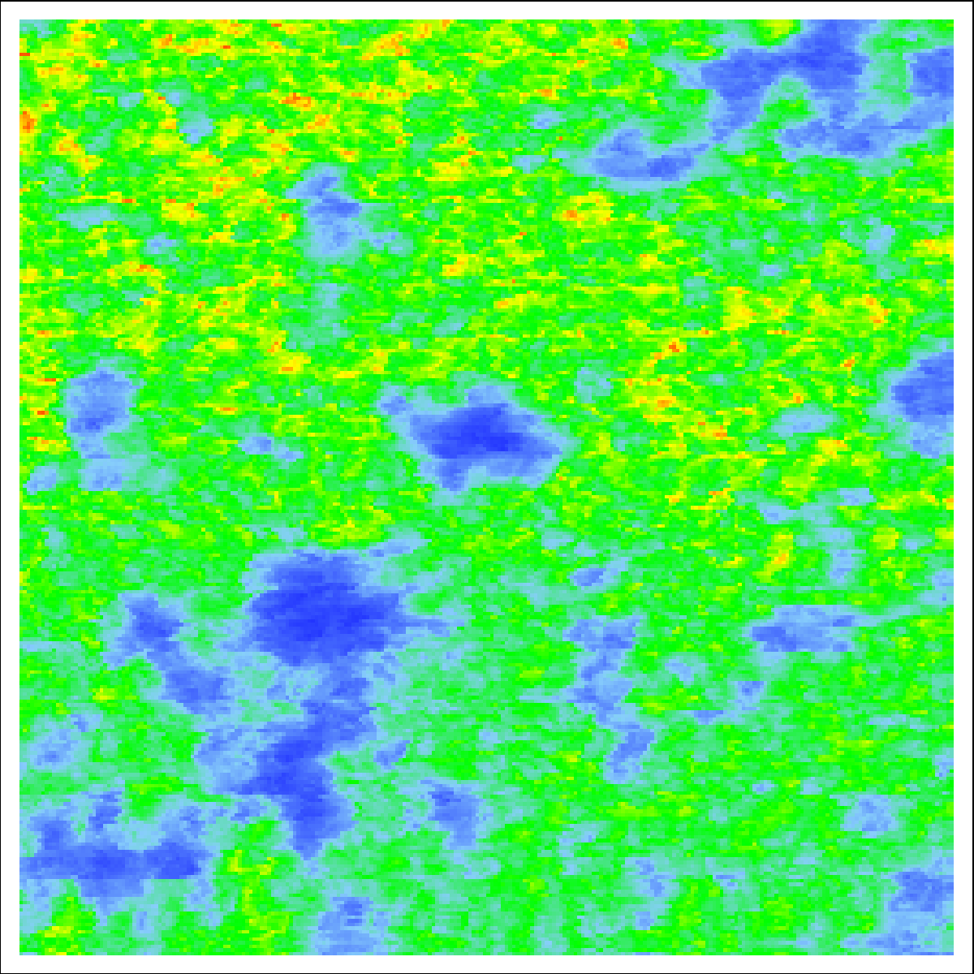
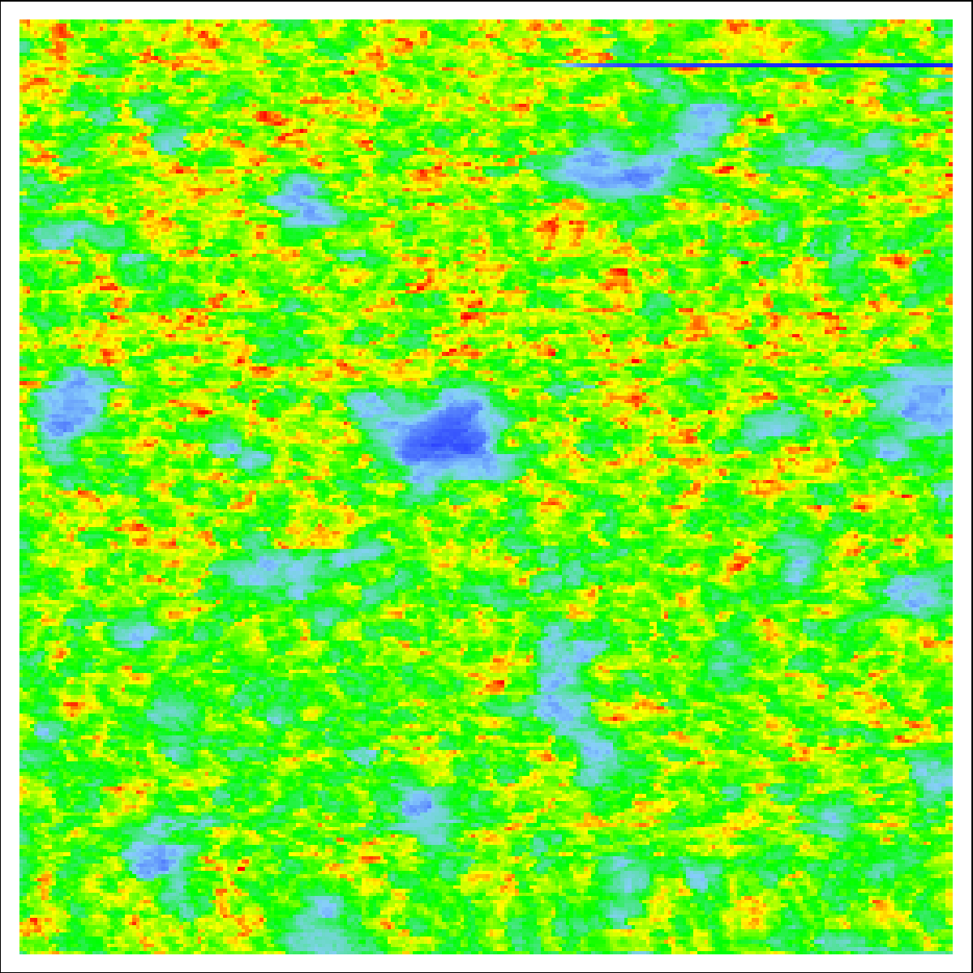





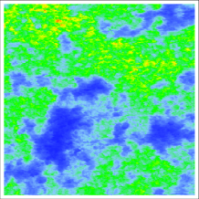

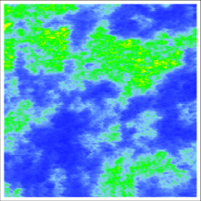
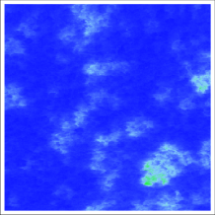

Is VO₂ hoogeneous?
Direct observation of inhomogeneity in VO₂
IR nanoscopy @ 930 cm⁻¹
IR nanoscopy @ 930 cm⁻¹
s²
ε₁
1 10 20
5 0 -5
ε₁
T=
5 0 -5
4 μm
T=
341 K
360
341.6
343.6 K
341.8
342.4
343.3
342
343
341.4
341
342.2
342.6
342.8
341.4
343.6
341.6
343.3
4 μm
20 nm
341.8
343
IR
342
342.8
342.4
342.6

Slide 22
Synopsis of my research
Broadband infrared spectroscopy of systems exhibiting phase transitions, collective phenomena and strong interactions
Metal-insulator transitions
High temperature superconductivity
Magnetic and structural transitions
New phases in 2-dimensions
Light-matter pseudoparticles
e.g. surface phonon-polaritons surface plasmons

